Slide 1
Emerging Trends in Higher Education: Games & Learning, Design & Development
Emerging Trends in Higher Education: Games & Learning, Design & Development
EMERGING TRENDS in ECONOMICS, CULTURE & HUMANITIES (etECH) 2019 | RIGA, LATVIA
Andrew Phelps
Professor of Human Interface Technology, University of Canterbiry, NZ
Professor of Art & Design, Rochester Institute of Technology, USA
Games Scholar in Residence, American University, USA
President, Higher Education Video Game Alliance
Founder, RIT MAGIC Center & MAGIC Spell Studios
Founder, RIT School of Interactive Games & Media

Slide 2
Today’s Talk
A bit about me
A bit of lived experience in teaching games for a while
A bit about games in higher education in the US, and elsewhere
A bit on games & learning
A bit on games & other fields
Q&A
AND LATER A ROUND TABLE DISCUSSION →

Slide 3
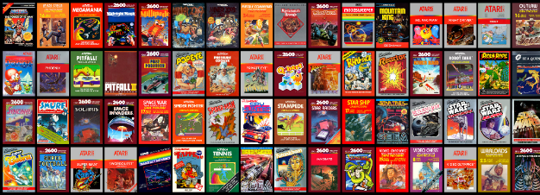
HI, I’m ANDY

Slide 4
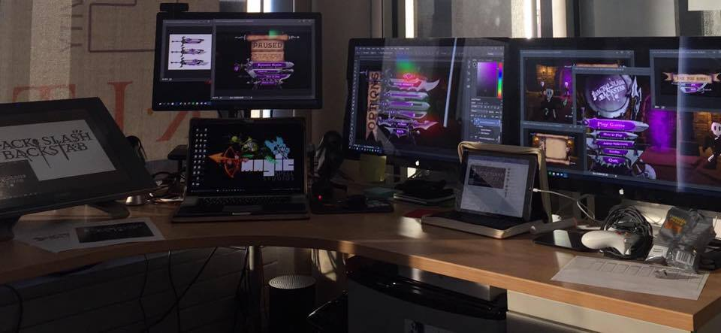
I make things.

Slide 5
RIT GAMES & INTERACTIVE MEDIA TIMELINES
2001 programming
First course in games programming
2002
Electronic Gaming Society
2003
CS/IT Concentration in Game Prog
2006
MSc Game Design & Development
2007
BSc Game Design & Development
2009
Dept. of Interactive Games & Media
2011
School of Interactive Games & Media
2012
Minor in Game Design
2013
RIT Center for Media, Arts, Games, Interaction & Creativity (MAGIC)
2013
MAGIC Spell Studios ®, LLC
2016
$30M MAGIC Spell Studios Initiative
2016
NY State Games HUB
2017
NY State Games Challenge

Slide 6
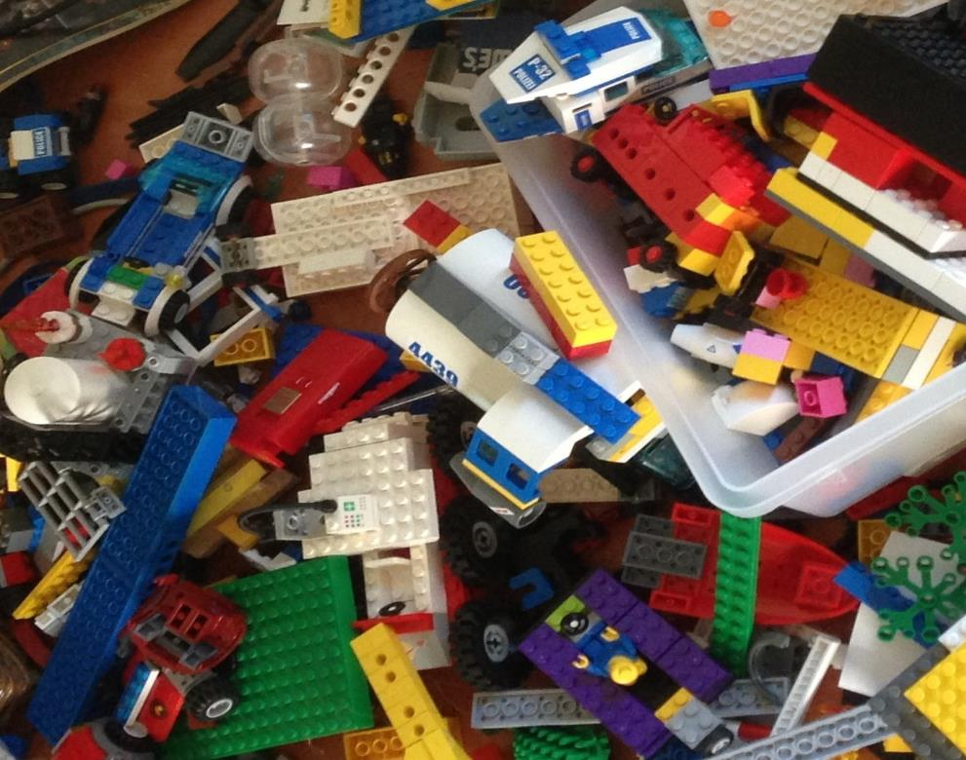
'protecting “making as a
mode of inquiry”’
-Ian Horswill, Northwestern
Notes:
This quote is from Ian Horswill, who said it, I think the first time? sitting on the floor of Microsoft Research at the MSR Faculty Summit a number of years ago. It has been rolling around in the back of my brain ever since – and it was the fundamental thing upon which MAGIC was founded, that somehow design research, making prototypes to test ideas, learning by making new things and new experiences, needed to be recognized and valued. At RIT we’ve sometimes used the rhetoric of STEM and Research to de-value those activities in weird ways.

Slide 7
School of Interactive Games & Media

Slide 8
INCREDIBLE ALUMNI
ALEX CUTTING
Senior Assoc. Producer HALO
Microsoft / 343
CLAUDE JEROME
Gameplay Designer DESTINY
Bungie
DUSTIN KOCHENSPARGER
Line Producer DLC
DESTINY
Bungie
SELA DAVIS
Platform Engineer
XBOX / XBOX Live
Microsoft
VReal
ANNA SWEET
Director of 3rd Party Development
STEAM
Valve
Oculus
Caffeine.ty
Microsoft XBOX

Slide 9
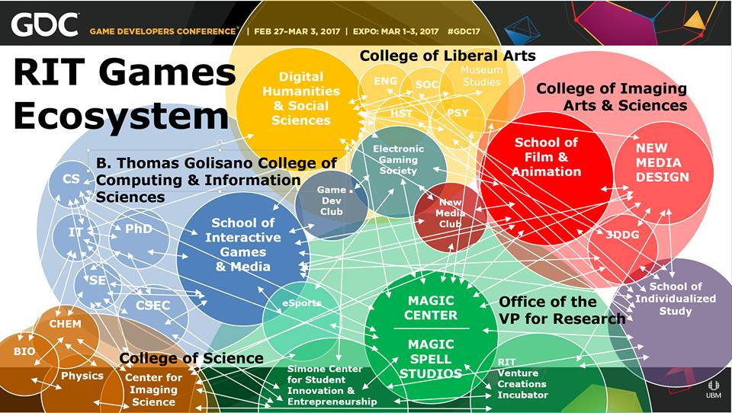

Slide 10
WE LEARN BY MAKING THINGS
Notes:
This is an architectural rendering of the lobby of the new MAGIC Spell Studios building. It will display our tagline ‘We Learn By Making Things’ which is based in part off of Ian’s statement, and reflection that this is a core value of RIT (whether it remembers it all the time or not ;) )

Slide 11
HOW IS MAGIC:
A VERY IMPORTANT DIVISION:
Notes:
Right from Bill’s ‘idea lab’ paper was the idea of an entrepreneurial effort inside the center to help publish and commercialize the things we make. We wanted to call it ‘MAGIC Studios’ at first but we were very afraid we’d get in trouble with The Mouse.

Slide 12
MAGIC TODAY & TOMORROW
Notes:
So let’s take a little look at where we are today, in our current home, what we’ve built, where we are going.

Slide 13
…The M is for Messy
Notes:
The M is for Messy.

Slide 14
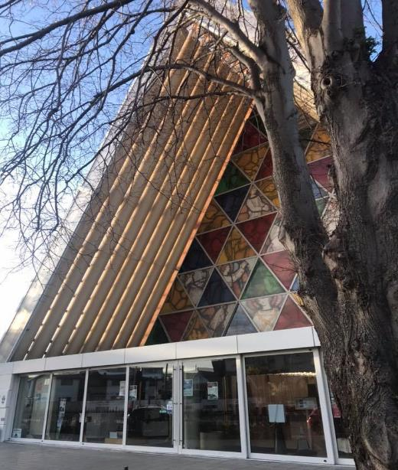
Teaching game production (the last ~5 years)

Slide 15
A Strange Game for Strange Reasons
This game taught us (the campus) about making things, production, and scale
This game allowed us to explore using typical game forms for telling a unique story to a very targeted audience
Finalist at GLS Education Arcade, shown at DiGRA Blank Arcade, and IndieArcade at the Smithsonian American Museum of Art
SPLATTERSHMUP.RIT.EDU – PLAY TODAY! MAKE ART!

Slide 16
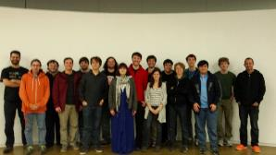
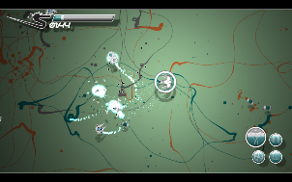
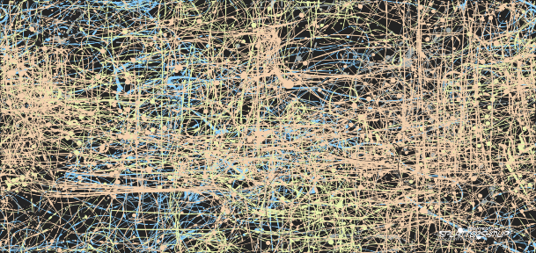

Slide 18
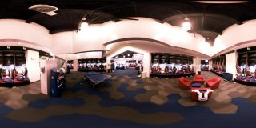
A SUMMER WITH THE BUFFALO BILLS
Notes:
A big high-vis project that was (a) external client through the studio, (b) multi-disciplinary team, (c) primarily managed entirely by staff

Slide 19
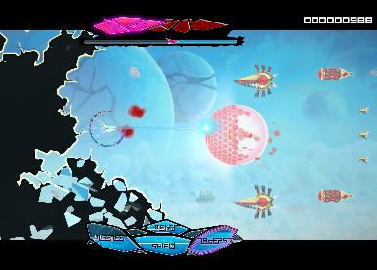
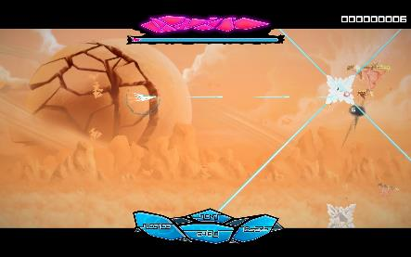
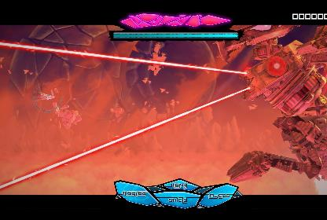

Slide 20
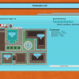
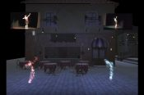
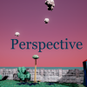
5 YEARS OF LEARNING THROUGH MAKING AT MAGIC. 5 YEARS OF PROJECTS & MEDIA.
Notes:
So I highlight those 3 because of the things we learned and as data points of growth, but the thing is we did a LOT of stuff from a LOT of work for a LOT of people! It’s a lot bigger a community than people even think about. It’s easy when you are working on ‘your thing’ to not realize the scope and scale of everything else that’s happening and going on.

Slide 21
CORE DESIGN PRINCIPLE
NO SPACE SHOULD BE USED FOR ONLY ONE THING, OR BY ONLY ONE CONSTITUENCY: OUR COMMITMENT TO MULTI-DISCIPLINARY AND CROSS-DISCIPLINARY WORK SHOULD EXTEND TO THE PHYSICAL BUILDING DESIGN, TECHNOLOGY SELECTION, ADMINISTRATION AND OPERATIONS, CULTURE & COMMUNITY.
WE WERE TRYING FOR A PARTICLE ACCELERATOR FOR THE HAPPY ACCIDENT.
(AND MODEL FOR OUR STUDENTS HOW COLLABORATION AND TEAMS FUNCTION)

Slide 22
HOW DOES THAT APPLY MORE BROADLY, MORE GLOBALLY?

Slide 23
A little bit on the history of games in higher ed
GAME STUDIES
Circa 2001 I offered a course in ‘game programming’ that was so new the NY Times showed up to over my course. It was a weird day.
There was a mailing list of the other folks I could find that had a game development course in the states. There were 6 people on it.
Similar trajectory in game dev, games studies, game design, game art
GAME DEV
GAME DESIGN
GAME ART

Slide 24
TODAY, THERE ARE 521 COLLEGE PROGRAMS IN NORTH AMERICA ALONE
THESE RANGE FROM GAME DESIGN, GAME DEVELOPMENT, GAME STUDIES, GAME ART, COMPUTING, ENGINEERING, AND MORE IN FORMAL AND INFORMAL PROGRAMS, MAJORS, MINORS, AND COURSES
Notes:
ARE WE IN YOUR STATE? Data map from Entertainment Software Association

Slide 25
FIELD REPORTS & EXAMINATIONS

Slide 26
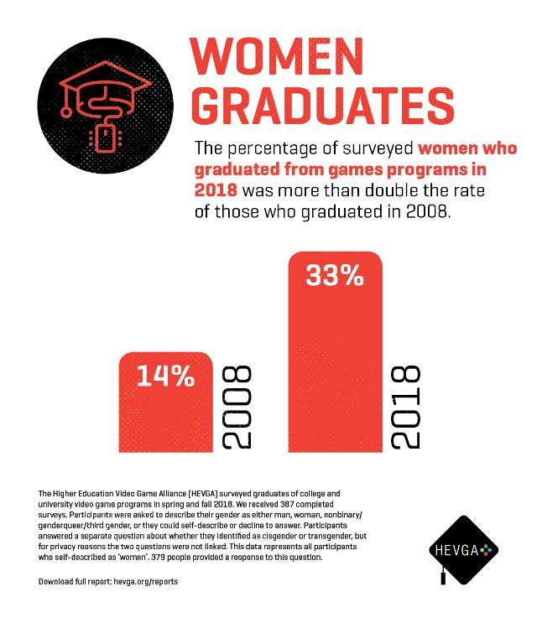

Slide 27
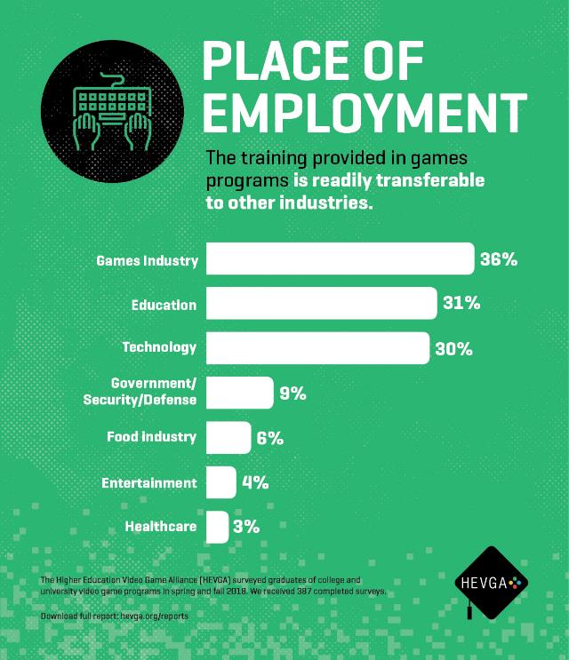

Slide 28
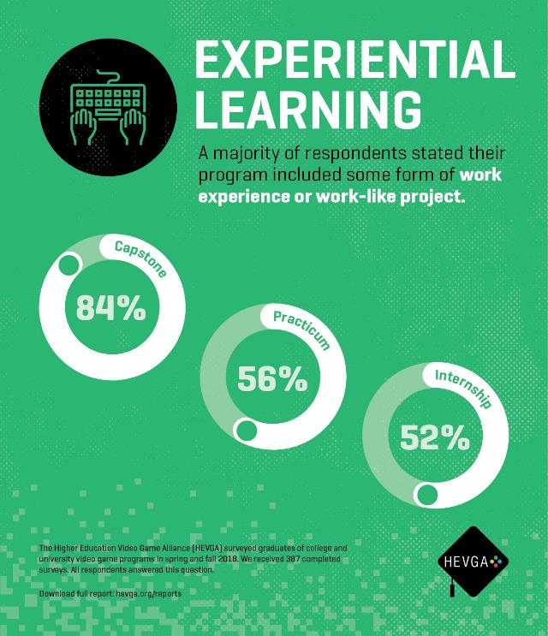

Slide 29
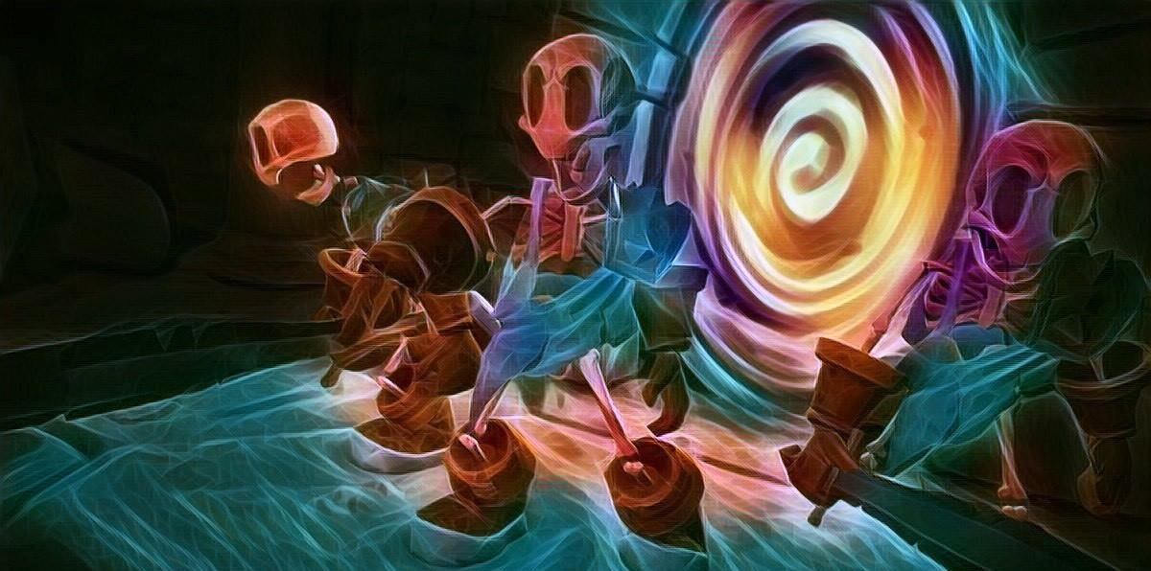
WHATS NEXT FOR GAMES in higher ed?
Increasingly, games programs are known not just for alumni, equipment, labs, faculty, or curriculum, but for what gets made there.
Research into core areas of computing continues to be critical, but of ever increasing importance is how new discoveries are applied at scale
Similarly, computing is at a crossroads regarding its ethical application, and games are in the cross-hairs of that in several contexts
What we are learning from games has some very broad implications for how people expect to interact with technology & art writ large

Slide 30
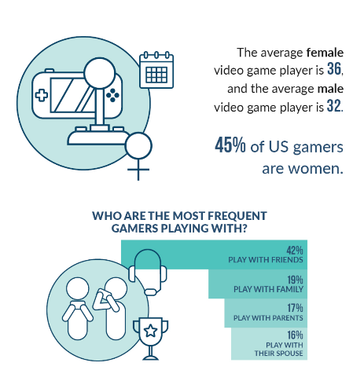
We are still moralizing the positioning and attention to games
This plays out as a response to moral panic
A need to “justify” time/money/resources spent studying them?
A focus on “applying” them to other things, often without understanding them on their own
Evaluating them on metrics we are more ‘comfortable’ with
None of the stereotypes hold

Slide 31
RESEARCH || AFFIRMATION
Ferguson’s conjecture is that given the WHO there will be a sustained interest in either approving (more likely) or disproving (potentially) the underlying thesis of addiction.
Pryblyzski’s conjecture is that we should get ready to face increased regulation and oversight (regardless of the short-term science, as it will take a long time to play out)
Within the academy, this has already started to warp some discussions about plans for new programs, particularly those centered on the intersection of games and health

Slide 32
ESPORTS AND POLICY
Substantial questions around funding models
Integration with academics has a variety of possible directions:
Production / media
Game design / development
Sports / Sports medicine
None (?)
Substantial questions around diversity and inclusion
Varsity / Intramural / Club
TITLE IX and associated compliance rules
Facilities, Equipment, Training, and Scheduling
Reporting & Oversight
Academic Affairs, Student Affairs, Athletics, ???
HUGE potential for learning pathways & communities

Slide 33
A few recent questions for the academy
Are we graduating too many ‘game graduates’ ?
Are we appropriately staffing games programs with a mix of academics and practitioners with actual experience in game-making?
How do we deal effectively with a field that finds itself spanning disciplines and academic cultures?
Multi-disciplinary work is, it turns out, rather more difficult than we like to let on… how do we structure participation and reward engagement?

Slide 34
ANDYWORLD.IO | PROFESSORANDREWPHELPS.NET | @RITIGM1 | ANDYMPHELPS@GMAIL.COM
Thanks & Questions

