Slide 1
Teaching Game Production & Creating Games for Social Good
ADOBE EDUCATION LEADERS NORTH AMERICAN SUMMIT | SAN FRANCISCO 2019
Andrew Phelps
Professor of Film & Media Arts, School of Communication
Director, American University Game Lab
American University, Washington DC
Professor of Human Interface Technology, College of Engineering
University of Canterbury, Christchurch NZ
President, Higher Education Video Game Alliance
@andymphelps | andyworld.io
Andrew Phelps
Professor of Film & Media Arts, School of Communication
Director, American University Game Lab
American University, Washington DC
Professor of Human Interface Technology, College of Engineering
University of Canterbury, Christchurch NZ
President, Higher Education Video Game Alliance
@andymphelps | andyworld.io

Slide 2
Part 0: Motivations & Ideas
Here’s the part where I think about the WHY

Slide 3
I WAS ASKED TO FRAME THIS TALK WITH RESPECT TO
“Creative problem solving is the process of redefining problems and opportunities, coming up with new, innovative responses and solutions, and then taking action.
Global research shows that tomorrow’s jobs will demand creative problem solving skills. We asked 2,000 educators, policymakers and influencers how they are helping to prepare students to be creative problem solvers and succeed in the modern economy.”
- Adobe Education, 2019
http://cps.adobeeducate.com/
But instead, I’m going to frame it about connections, emotions, and art.
Notes:
So we all got these materials on ‘creative problem solving’ as a general theme to what we were individually presenting. And that’s fine, and it’s good material. But honestly, there’s nothing there that really rocks the boat – it does from the perspective of “here’s a school district or a state or what-have-you that’s stuck on a particular penchant and needs a justification to provide engagement with the arts or technology or whatever that isn’t an ultra-conservative stem-based approach, or to step outside disciplinary boundaries in higher ed like ABET, but honestly for those of us practicing in this community it’s a lot of choir preaching. Which is necessary to some extent, but let’s kick it up a bit…

Slide 4
Notes:
Image from https://i.ytimg.com/vi/aoqqoPMvtjk/maxresdefault.jpg from the “Practical Psychology” you tube video at https://www.youtube.com/watch?v=aoqqoPMvtjk
NOTE: This isn’t actually how brains work, nor is it really even that great a model (as the video points out), but it is still a prevalent meme in our pop culture for a variety of reasons
BUT we still use this kind of reasoning all the time when we talk about quant/qual debates, which are equally as insane

Slide 6
Notes:
Yayoi Kusama. INFINITY MIRRORED ROOM - MY HEART IS DANCING INTO THE UNIVERSE, 2018. Wood and glass mirror room with paper lanterns, 304 x 622.4 x 622.4 cm (119 5/8 x 245 1/8 x 245 1/8 in). © Yayoi Kusama. Courtesy Ota Fine Arts, Tokyo / Singapore / Shanghai and Victoria Miro, London / Venice.
https://www.studiointernational.com/index.php/yayoi-kusama-moving-moment-when-i-went-to-universe-review-infinity-mirror-victoria-miro

Slide 7
Notes:
Image from the ‘pink Floyd’ section of the berlin wall: https://www.tripadvisor.com/LocationPhotoDirectLink-g187323-d196239-i220900769-Memorial_of_the_Berlin_Wall-Berlin.html

Slide 9
BUT If I wanted to examine creative problem solving in that context…
Games are interesting because they allow for a complex, open-ended simulation. When you study players they 1) have a theory of how to achieve their goal, 2) try it in the game, 3) observe and analyze the result, 4) revise their hypothesis, and 5) retest & reexamine. They learn about the world of the game through the repeated practice of the scientific method. They construct a working understanding of the world/rules and then optimize it and abstract it. With points for being weird and cultural affirmation of creative solutions. This is a form of systems-oriented thinking, and it makes games a powerful learning platform.
Notes:
I gave a TED style talk a decade or so ago on games as learning tools using the example of rocket jumping as a way to illustrate that gamers learn about systems, about rulesets, and them optimize them in unique and wonderful ways. And that if we make games about rulesets that have more in common with real world problems, then we could get ‘rocket jumping for climate change’ or any number of other solutions. Games are awesome for systems oriented learning but it means making games that actually model the systems well which is REALLY HARD and then letting people actually play with them in an open ended way which is also REALLY HARD, especially in the age of EARLY ASSESSMENT OR DIE.

Slide 10
Part 1: Teaching Game Production
Here’s the part where I talk about the WHAT, the WHO, and the HOW

Slide 12
A Strange Game for Strange Reasons
This game taught us (the campus) about making things, production, and scale
This game allowed us to explore using typical game forms for telling a unique story to a very targeted audience
Finalist at GLS Education Arcade, shown at DiGRA Blank Arcade, and IndieArcade at the Smithsonian American Museum of Art
SPLATTERSHMUP.RIT.EDU – PLAY TODAY! MAKE ART!
Notes:
I made a game about painting. That was weird.

Slide 13
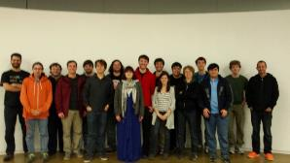
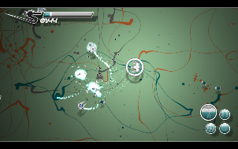
Notes:
You could paint with it and it hopefully taught people about things like line and form and space. Reference the Jackson Pollock interviews where he talked about ‘attacking the canvas’ and the ‘field of battle’ and all that stuff.

Slide 14
Notes:
I made a game about campus politics. Neat.

Slide 15
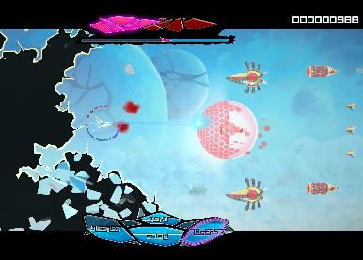
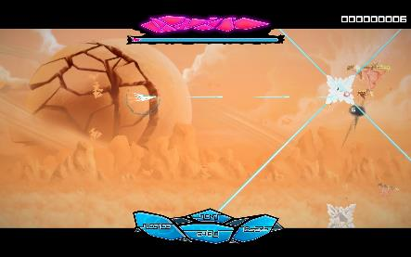
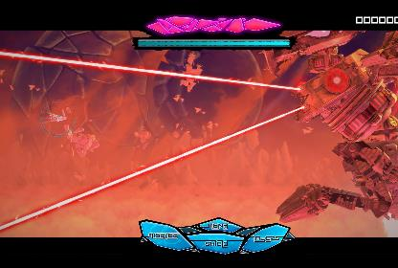
AVAILABLE NOW on XBOX One® Steam® and Itch.io – fragileequilibrium.net
Notes:
I made a game about depression and anxiety and feeling squeezed. It took 2.5 years.

Slide 16
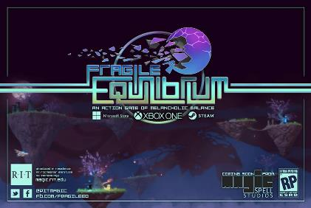
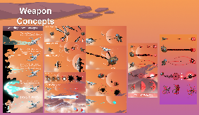
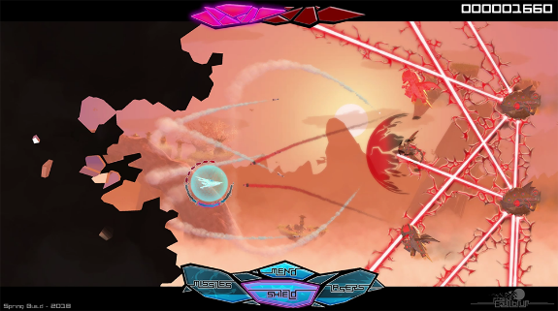
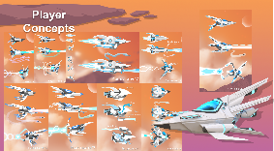
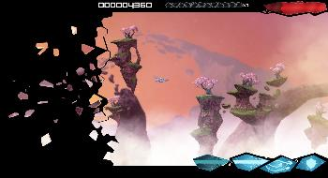
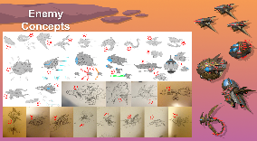
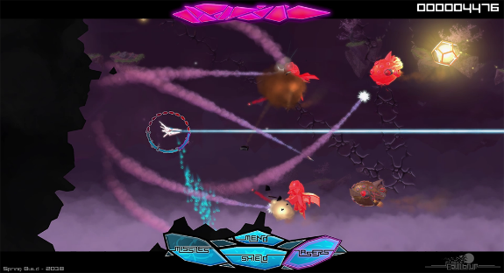
Game, UI/UX, Iterative Design, etc. etc...
Notes:
No really, 2.5 years. Iterative development with a large team. Complex workflows. All that stuff.

Slide 17
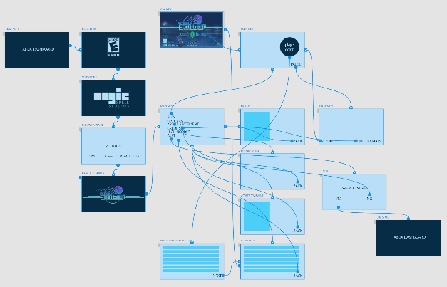
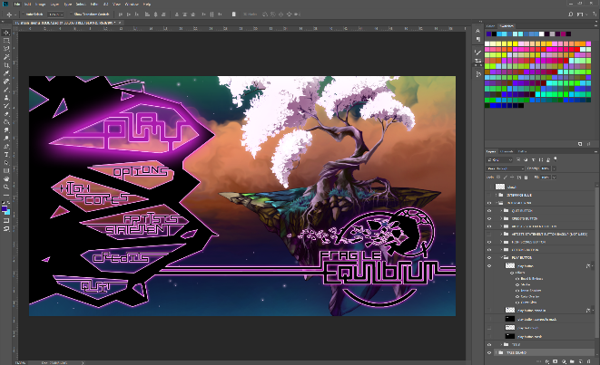
Yes, Adobe Tools are a part of Game Development ☺
Notes:
And there were adobe tools. I presented on this at MAX last fall. And now the XD team has taken that feedback and incorporated it into the toolset. So I like to imagine it had some effect.

Slide 18
Communications & Team Infrastructure(s)
Notes:
This also taught students how to deal with being in multidisciplinary teams and communicate about development, which is, honestly, another thing that is really, really hard.

Slide 19
Part 3: What Was That Really All About?
Here’s the part where I relate back to the WHY a little bit

Slide 20
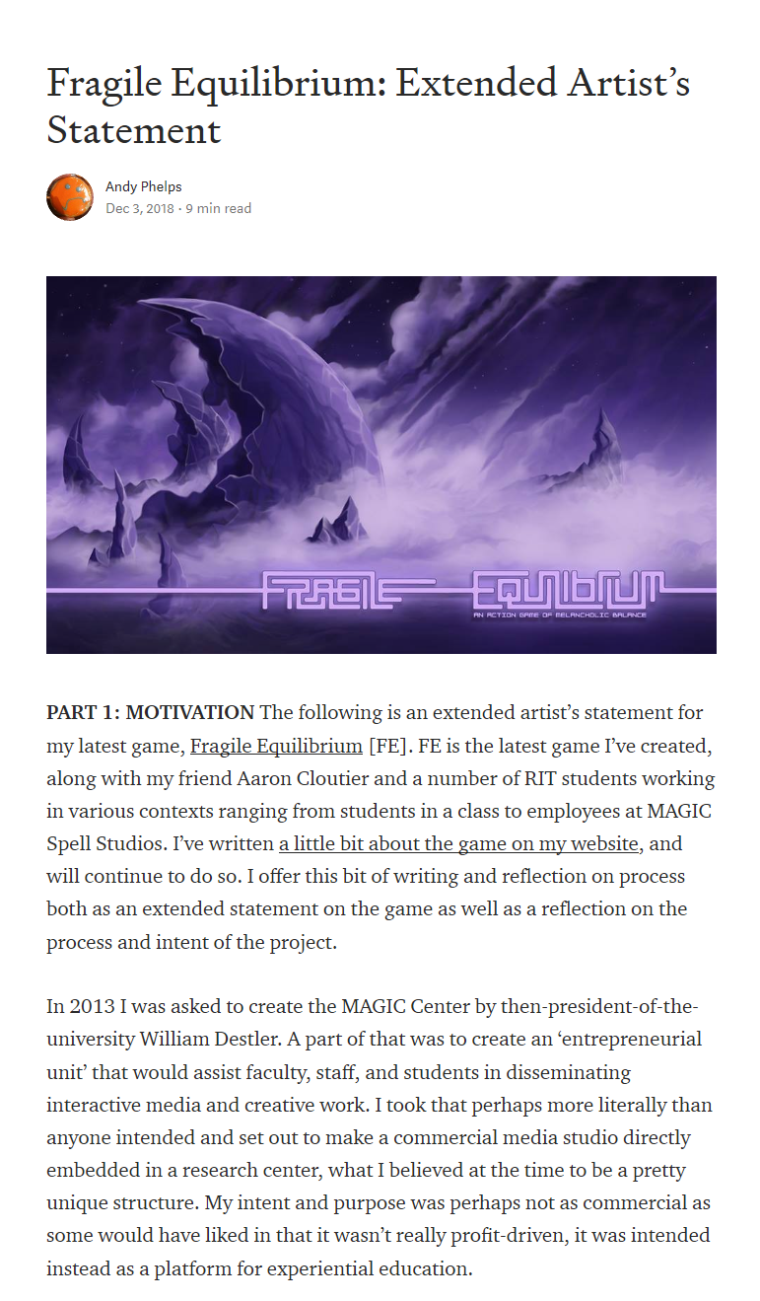
Those games were not about tech, or skills, or production at all…
This is all a metaphor for living with depression. Some of it is very literal: the very idea of the view of the world ‘breaking’ and ‘cracking’ comes from descriptions I’ve read of depression as making life ‘brittle’, a series of tasks or hurdles to ‘get through without breaking’. A day divided into little pieces. But more deeply, depression is a thing that alters how you move through life. It becomes a constraint. It becomes, unless dealt with, an all consuming thing that allows no other force or action, no space, no breath, no life of purpose. That is what it means to consume the world. To consume a mind. To consume a person. It is a thing that takes hold of a person and can reduce them to a shell. To a shard. To a piece of broken glass.
Notes:
So honestly, none of those games are about the game. They are about art, or about review metrics, or about depression. I was specifically trying to get my developers to think about topics WAY BEYOND making a game and engaging people with ‘a game mechanic’ and so on. I hope I inspired them to really engage with something that was a little closer to engaging with other humans about a given thing.
I knew, for example, that the painting game would work with Michael couldn’t put it down because it was ‘a new and interesting way to draw’
I knew HSB worked when people played it and ‘didn’t like the people they played it with quite as much’
FE works for the folks that play it and get the sense of nostalgia, like Doris

Slide 21
Part 4: So What Happens Next?
Here’s the part where I speak to the new version of WHERE, and WHY

Slide 22
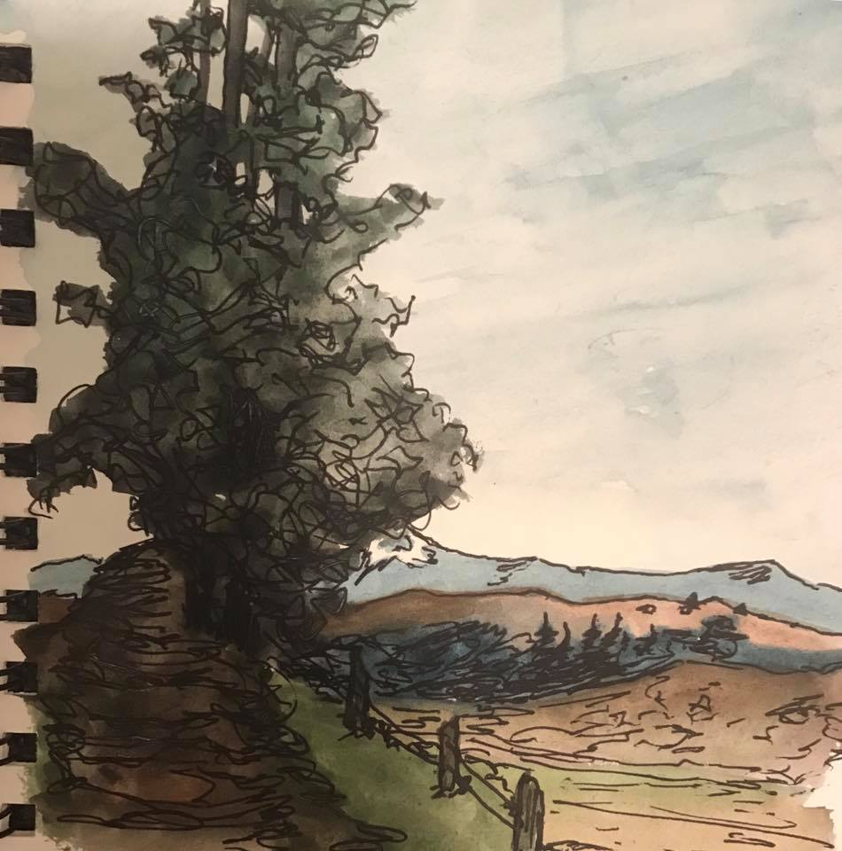
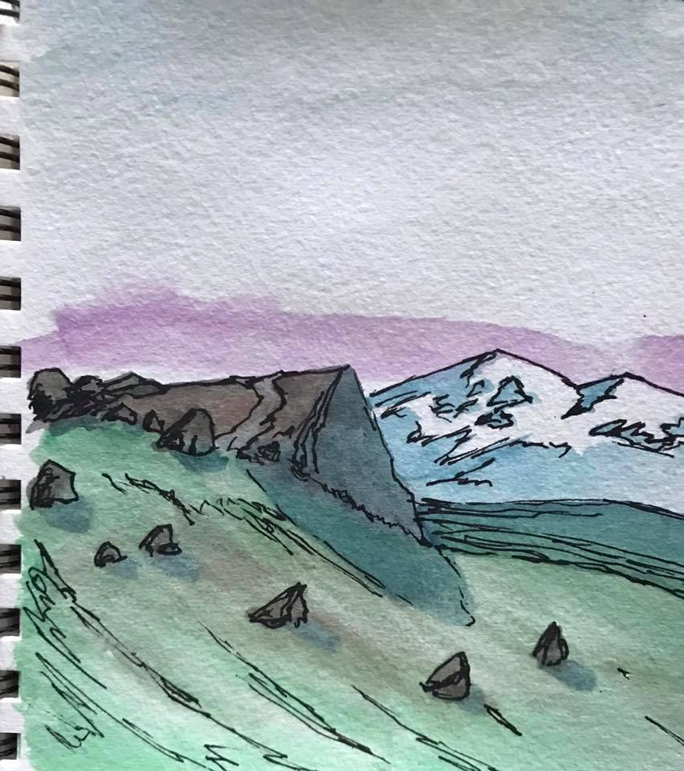
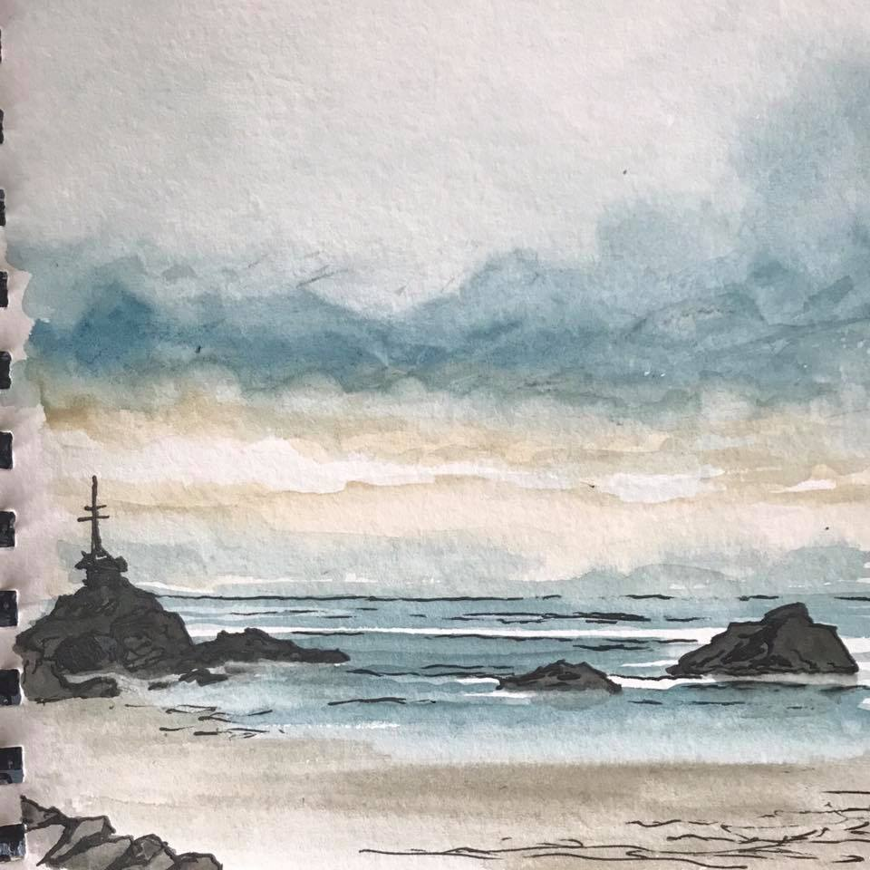
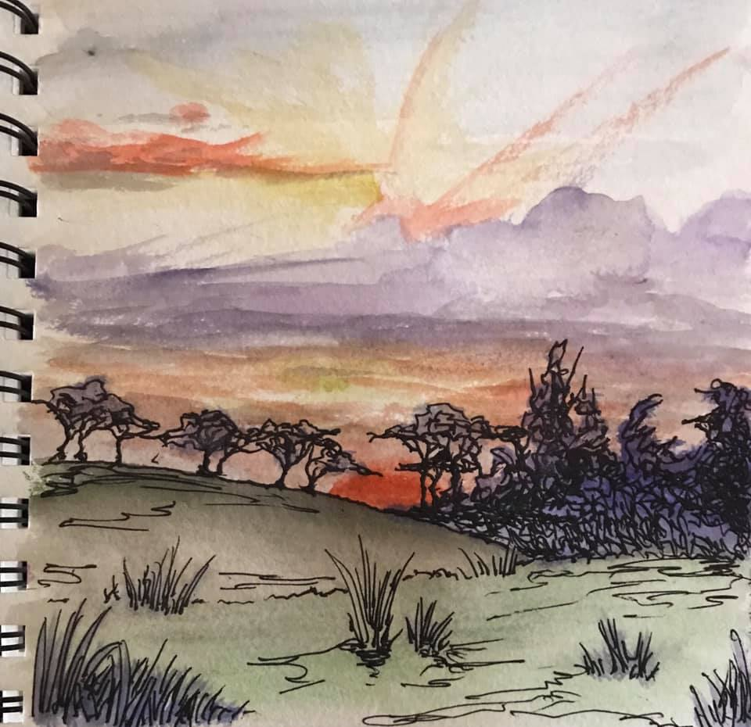
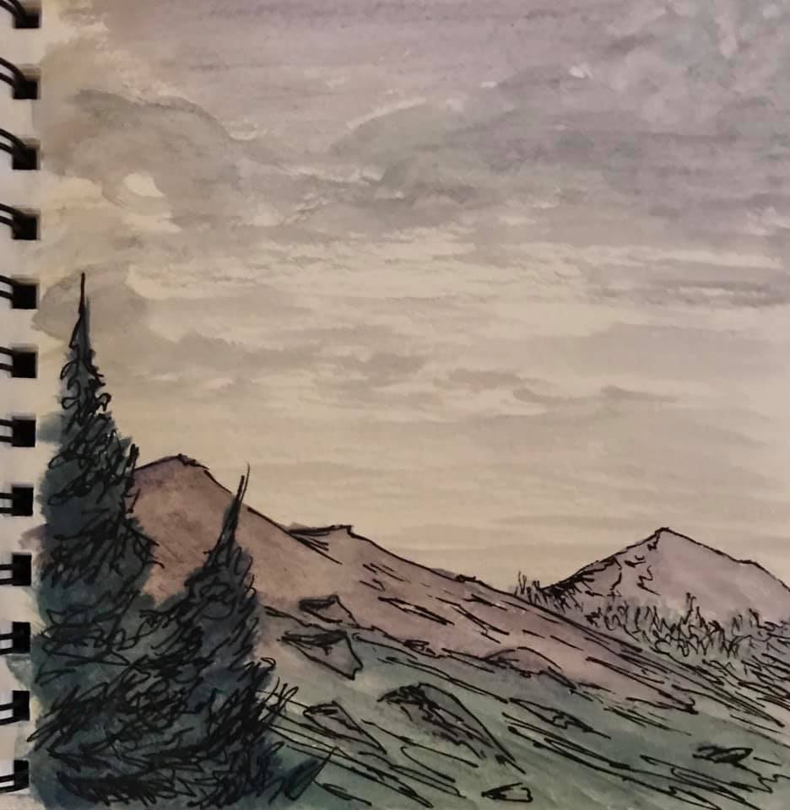
I went to New Zealand and Fell In Love With Engineering Again
Notes:
So I went to NZ and they have some kickass engineering groups

Slide 23
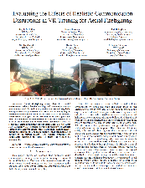
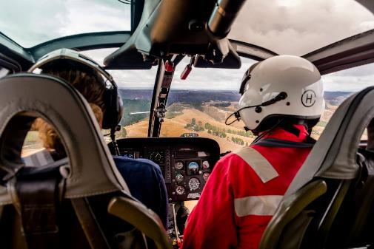
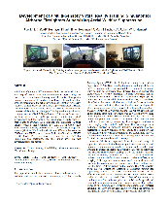
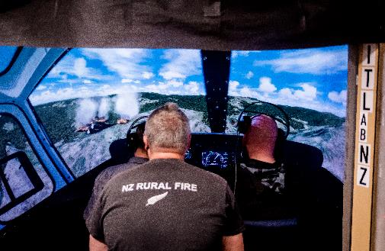
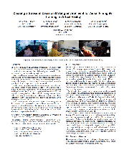
VR Simulation for Aviation (and Ground) Training in Fire Fighting
“The system aims to improve personnel confidence, task proficiency and response time, for greater efficiency and reduced risk or loss of life.”
Air Fire Fighting
Lead by PhD student Rory Clifford
Rob Lindeman is his Supervisor
Ground Fire Fighting
Lead by Hendrik Engelbrecht
This is being supported by the NZ Fire and Emergency Service.
Rob Lindeman is his Supervisor
Notes:
Currently, aviation firefighter training is expensive, risky and time consuming. It also lacks the mental challenges and physical exhaustion of an actual wildfire. Training events are infrequent, causing a great loss in ability or skill retention. This lack of exposure leaves firefighters inadequately prepared for duty which involves the co-ordination of people in multiple aircraft over a dangerous fire ground.
This project looks at the problem of the training deficit in aviation firefighting. We have designed a immersive virtual reality training simulation for Air Attack aviation firefighting. This system can be used more frequently by firefighters and aviation personnel to improve training opportunities. Core duties can be practiced such as radio communication, decision making and teamwork skills, with the added benefit of a simulated fire ground to train situational awareness. The system aims to improve personnel confidence, task proficiency and response time, for greater efficiency and reduced risk or loss of life.
This is the kind of thing they do – use technology to make inroads on a current, otherwise intractable problem.

Slide 24
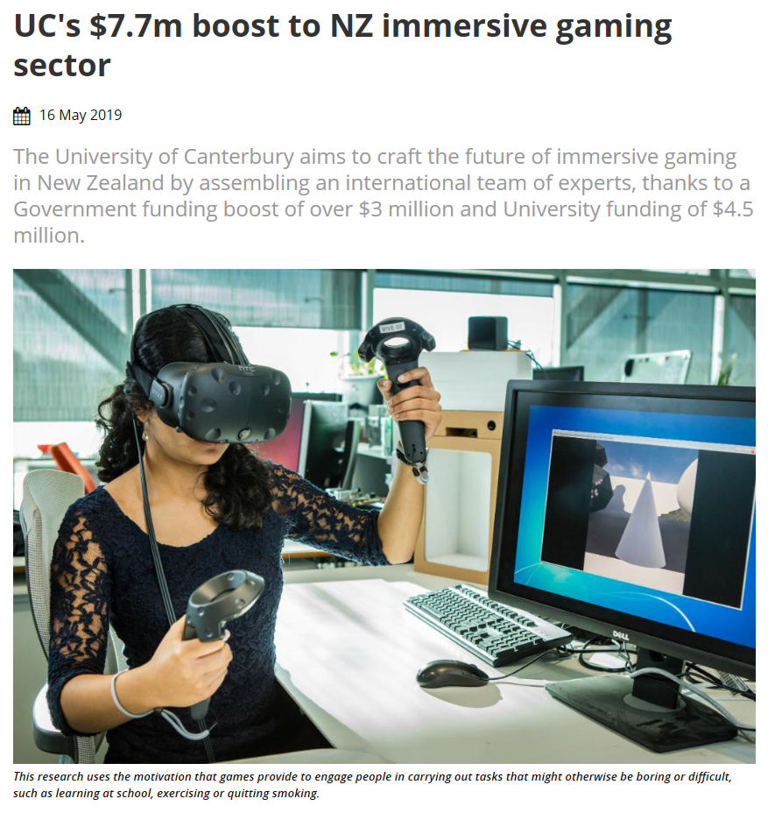
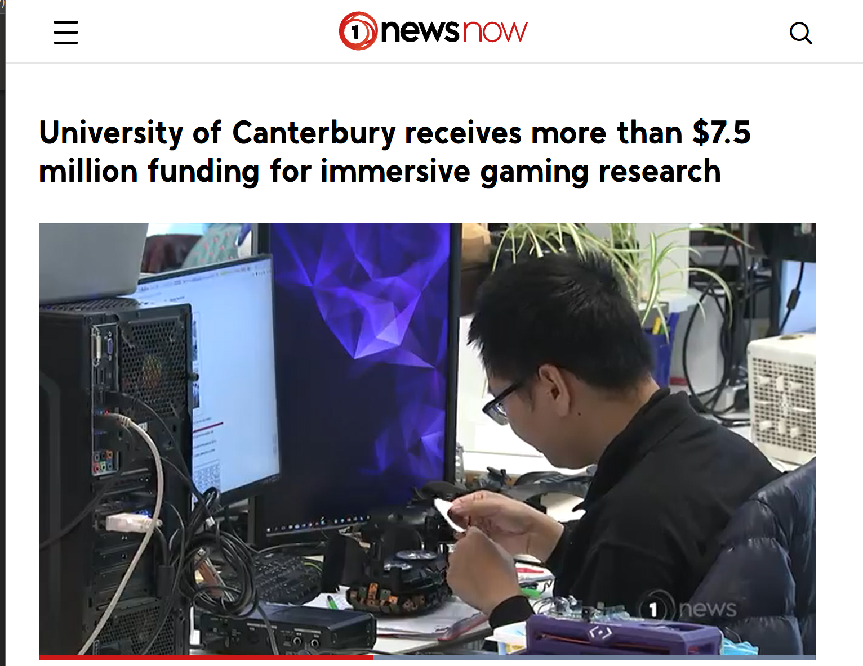
Applied Immersive Games Initiative
Notes:
But they got ME excited when they started this notion of ‘Applied Immersive Games’ – ie using games CONTENT in AR/VR/MR/XR specifically around social good. Exercise, addiction, health, training, education, etc.

Slide 25
Games for Social Impact, Persuasion, Politics & Policy
Notes:
And that lead me to the second thing I’m doing, with the AU Game Lab. Which is the same style of intervention, but more broadly centered on games writ large regardless of tech (although I personally remain interested in the “immersive” component, even if I don’t particularly enjoy that terminology)

Slide 26
Example: Factitious
Notes:
Factitious by AU Game Lab (Bob Hone and Lindsay Grace) is a great example of a game in a particular moment that addresses a particular cultural hotspot. In Factitious you have to identify real vs. ‘fake’ news, along several axis (news, ads, opinion, fake, etc.) and over time your biases become apparent. And it’s a pretty good tool in that *multiple* biases become apparent!
CHI EA '19 Extended Abstracts of the 2019 CHI Conference on Human Factors in Computing Systems Paper No. CS05
“This case study describes a game designed to serve as new literacy education tool, playful polling system for research audience perceptions. The game underwent two primary designer iterations. As a result of design changes and renewed political chatter about fake news, the game's second iteration gathered more than 500,000 plays. The data collected reveals useful patterns in understanding news literacy and the perception of play experiences. This data of more than 45,000 players, indicates that the older the person the better they are at identifying fake news, until the approximate age of 70. It also indicates that higher education correlates to better performance at identifying real news from fake, although the time it takes to do so varies. This case study demonstrates the potential for such game designs to collect data useful to non-game contexts.”

Slide 27
Part 5: Conclusion
Here’s the part where we find out if this made any sense, or inspired anyone

Slide 28
Games as Art
If games are art means they have a responsibility to speak to the human condition, and in this day and age to perhaps speak truth to power. To use the fact that they are systems to convey the dangers of systems and the idea that 'creative problem solving' and 'technology' can do some real evil when we divorce the responsibility of invention and affect.
Notes:
Fortnite wallpaper: https://www.bing.com/images/search?view=detailV2&id=CE15B343C1DC2C83C4CA275484A5E72A42DAFFD2&thid=OIP.TEQ1bOX6GOT2bzI2gJJZDQHaDt&mediaurl=https%3A%2F%2Fprogameguides.com%2Fwp-content%2Fuploads%2F2018%2F05%2Ffortnite-loading-screen-abstrakt.jpg&exph=1024&expw=2048&q=fortnite+screen&selectedindex=1&ajaxhist=0&vt=0&eim=1,2,6
Because fortnite is front and center of the current public debate around games. And also around the notion of what we CAN and COULD do with games.

Slide 29
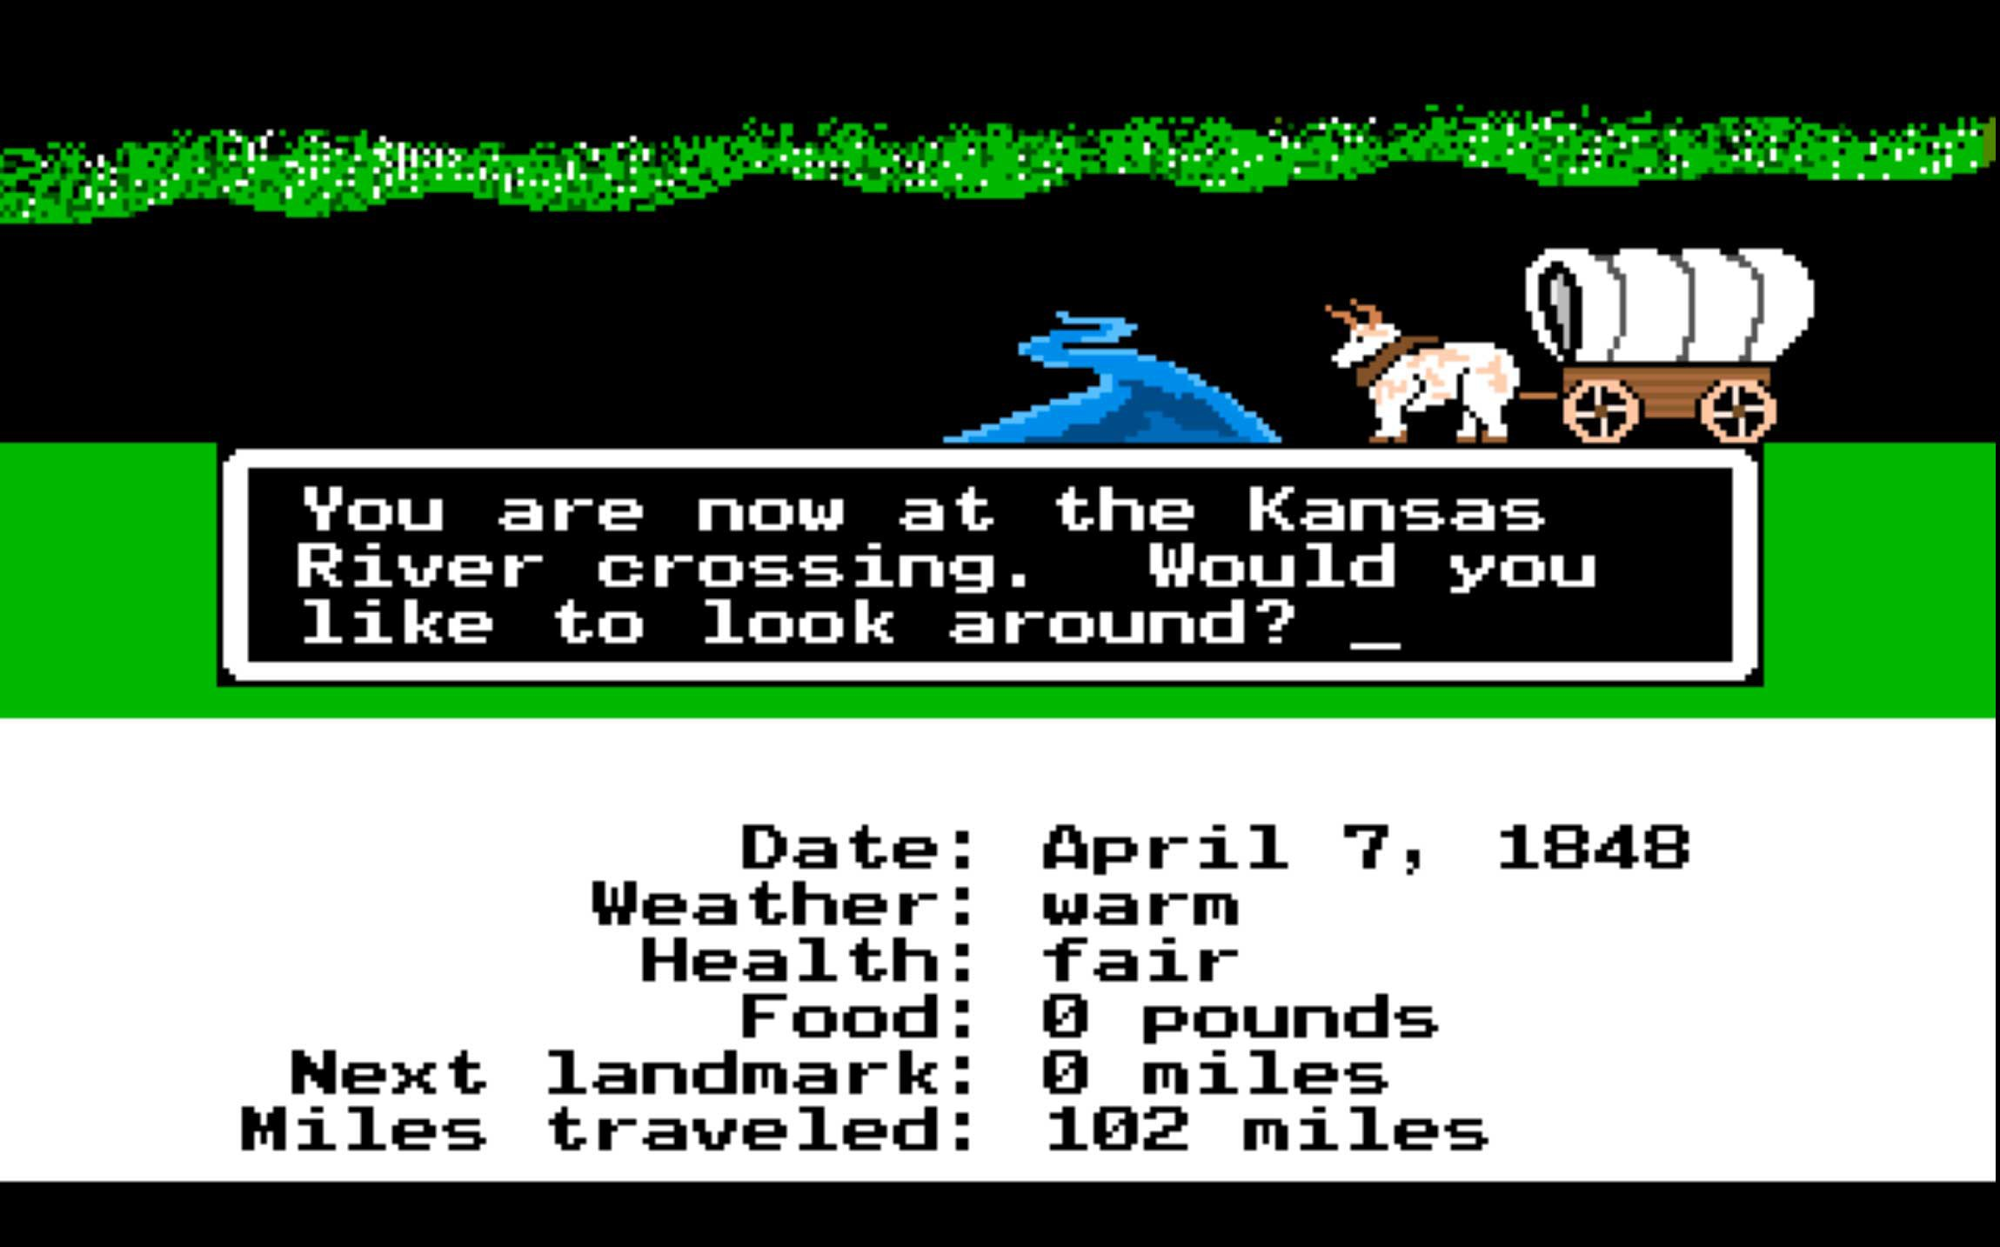
Games and Education, Games and Social Good
When we speak to using games in education, either as tools, frameworks, or contexts, it means we must remember that the purpose of education is not merely skills, career preparation, creative problem solving, or even life-long learning:
education also deals in empathy, civility, citizenry, democracy, discourse, and culture.
Notes:
Oregon trail. Because Oregon Trail.

Slide 30
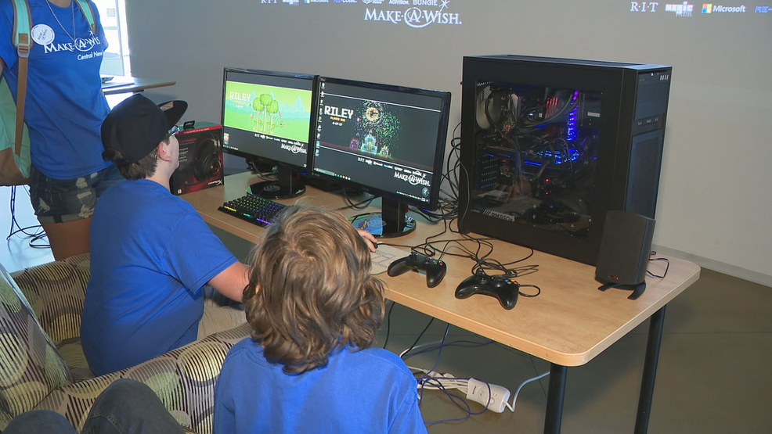
Creative Problem Solving
If we are to focus on “creative problem solving”, we must understand ourselves as both a part of the problem and [hopefully] part of the solution. Technology is a tool. Please remember humanist approaches to your engagement with students, even in the face of STE(A)M, organizational politics, funding, jobs, and fascism. We do not design in a vacuum or teach without consequence.
In my way, I tried (and am trying) to work with developers and engineers in ways that ideally inspire them to reflect on the soul of what they make, and the souls for whom they make it. That is how I think creative solutions can happen for the next generation.

Slide 31
ANDYWORLD.IO | PROFESSORANDREWPHELPS.NET | @ANDYMPHELPS | ANDYMPHELPS@GMAIL.COM
Thanks & Questions

