Slide 1
Performing Game Development Live on Twitch
Mia Consalvo
Professor of Communication Studies
Canada Research Chair for Games Studies & Design
Founding Director, mLab
Centre for Technoculture, Art & Games (TAG)
Concordia University
Andrew Phelps
Professor of Art & Design
President, Higher Education Video Game Alliance
2019 Games Scholar in Residence, American University
Founder, RIT MAGIC Center & MAGIC Spell Studios
Founder, RIT School of Interactive Games & Media
Rochester Institute of Technology
Hawaii International Conference on Systems Science

Slide 2
BACKGROUND LITERATURE
Game industry studies
Co-creativity (John Banks)
Game talk (Casey O’Donnell)
Live streaming gameplay
Broadcasting play (TL Taylor)
Hamilton W. A., Garretson O., & Kerne A. (2014, April 26–May 1). Streaming on Twitch: Fostering Participatory Communities of Play within Live Mixed Media. In Proceedings of the SIGCHI Conference on Human Factors in Computing Systems (CHI ’14). New York, NY, USA.

Slide 3
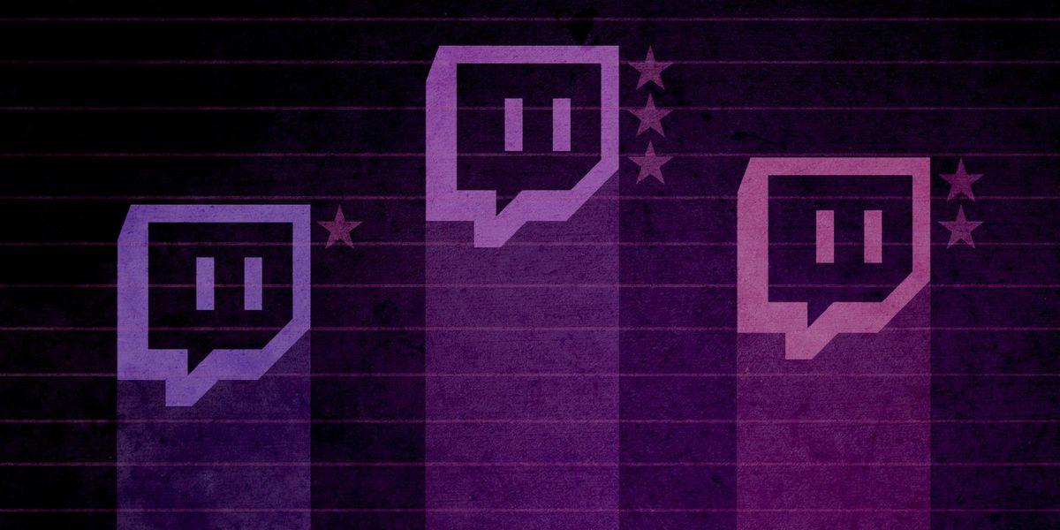
SOME GAME-DEV CULTURAL AND DEVELOPMENT BACKGROUND
“Cloud of Secrecy” regarding game development (O’Donnell and others)
the work of game development is becoming more public facing, as smaller (usually indie) developers are actively writing about their processes and challenges on blogs and streams
O’Donnell also writes about the importance of “game talk” – a shorthand for workers to use that abstracts from references to older games or game genres
Co-creative cultural production, which is a “bottom-up and peer-to-peer dynamic among amateurs,” that also requires “the craft skills and knowledge and commitment of professionals and experts” (Banks)

Slide 4
GAME DEVELOPMENT IS NOT WELL UNDERSTOOD
Notes:
From the infamous “tighten up the graphics a little bit” line in a commercial by Westwood College, which in modern meme slang now means 1) to work at an introductory-level tech position, and/or 2) to attempt a feat without knowledge of how it can be done. (Urban Dictionary: https://www.urbandictionary.com/define.php?term=tighten%20up%20the%20graphics)
More formally, O’Donnel has noted the cloak of secrecy the games industry perpetuates is very purposeful (O’Donnell 2014). Consequently there is not a large, over-simplified public-cultural narrative around the creation of games in the same way there is for film or music, and aspiring developers often have significant difference as to what, exactly, it even means to design and/or develop games.

Slide 5
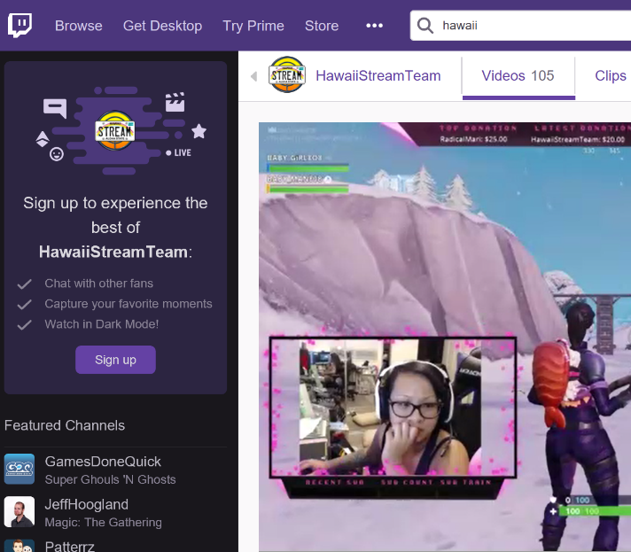
BACKGROUND ON TWITCH
Originally a spin-off of a general interest streaming platform - Justin.tv
Sold to Amazon in 2014 for $970M USD
In Feb 2014 it was the 4th largest driver of internet traffic worldwide
Twitch in turn purchased game community company Curse
As of May 2018, it had 2.2 million broadcasters monthly and 15 million daily active users, with around a million average concurrent users
Also as of May 2018, it had over 27k partner channels

Slide 6
A BIT ABOUT GAMES & STREAMING
live streaming of gameplay has become enormously popular and research about those practices has exploded. Initially most scholarly attention was on practices surrounding eSports games
research has expanded to those who engage in “variety streaming,” with the draw being a streamer’s personality. Hamilton, Garretson & Kerne argue that Twitch streams can act as “virtual third places, in which informal communities emerge, socialize, and participate”
Johnson & Woodcock point to how live streaming can push players to “building an audience”
Yet so far, work on live streaming in relation to games has focused almost exclusively on players.

Slide 7
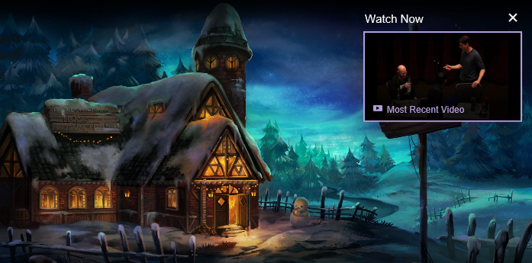
IDEA: MAYBE DEVELOPMENT STREAMING CAN HELP PUBLIC UNDERSTANDING OF GAMEDEV?
Notes:
Of course cracks have appeared in that wall of secrecy. Smaller and independent game developers have started to share information and best practices amongst one another (Browne, 2015; Whitson, 2015).
One recent development that has significant potential to demystify the practice of game making for the non-practitioner is the recent phenomenon of “development streaming” – i.e. the livestreaming not of a game being played, but rather a game being constructed. Live streaming of games being played has received growing attention from researchers, yet on sites such as Twitch.tv, we are seeing an increase in live streaming of creative activities as well. Recognizing that growing interest, Twitch (among others) has started creating categories to help interested viewers find such content, and the platform officially launched the “Game Development” category in late 2014 (Crecente, 2014).
https://www.twitch.tv/handmade_hero – “Handmade Hero is an ongoing project to create a complete, professional-quality game accompanied by videos that explain every single line of its source code. It is intended as an educational resource for people interested in learning how game engines are developed in practice.”

Slide 8
RETHINKING APPRENTICESHIP ?
Notes:
Various developers have begun to engage in such streams, from casual indie developers looking for accountability, sociality, and possibly seeking to support a portion of their work through advertisements or other funding mechanisms inherent in platforms like Twitch, YouTube, Mixer, Caffiene.tv, etc. to the occasional guest stream of a famous developer or designer discussing their process or sometimes just letting people ‘watch over their shoulder’ (Consalvo & Phelps, 2019).

Slide 9
METHODOLOGY
To investigate that activity and the discourse surrounding it, this project takes an exploratory approach, investigating how game developers utilize live streaming as part of their development process:
1) it investigates game developers’ public discussions of their streaming activities to see how they have talked about the process and its rewards as well as challenges (i.e. EXAMINES and ANALYZES VOCABULARY)
2) it engages in preliminary analysis of two game developer live streams (i.e. DIRECT OBSERVATION & RECORDING OF STREAM ACTIVITY)

Slide 10
ADDITIONAL POTENTIAL CRITERION FOR EVALUATING STREAMS
1) the degree to which formal and informal design processes and principles are discussed and presented to the audience
2) the type of design vocabulary employed in the stream sessions
3) how streaming as an activity forces (or fails to enforce) a type of reflexive self-study of the role of a game designer, developer and/or artist
4) the role of the stream audience during the live session as an interactive influence on the design of the game itself
5) the potential of the stream in question to help inform novice- or non-developers about issues and paradigms in game design, development and production
Notes:
To better understand this phenomenon, the authors are engaged in several studies exploring the phenomenon of development streaming and its potential impact. For this presentation, they have observed the streams of several designers, developers, and artists engaged in game production, and report on how these streamers understand game development as well as the authors experience and observation of how these streams’ language and descriptions of their activity reflects the work they actually engage in. Particular attention is paid to several facets of these streams, including: 1) the degree to which formal and informal design processes and principles are discussed and presented to the audience, 2) the type of design vocabulary employed in the stream sessions, 3) how streaming as an activity forces (or fails to enforce) a type of reflexive self-study of the role of a game designer, developer and/or artist, 4) the role of the stream audience during the live session as an interactive influence on the design of the game itself, and 5) the potential of the stream in question to help inform novice- or non-developers about issues and paradigms in game design, development and production.

Slide 11
RESEARCH QUESTIONS
How/in what ways do game developers engage in co-creative practices with audiences while live streaming their game development work?
How/in what ways do game developers engage in game talk with audiences while live streaming their game development work?

Slide 12
GENERAL DISCOURSE ON LIVE STREAMING & ASSOCIATED ISSUES
Most working developers make the case for a grass roots approach that will “build up a community” around the game being created…
A second goal for developers to live stream is [daily] accountability.
Additional goal to prevent cloning of the game by other developers
One of the most remarked on outcomes for streamers is feedback and/or help: both in terms of offering instructional help to others or gaining help or feedback from viewers

Slide 13
NOTIONS OF “AUTHENTICITY”
Nearly all developers cited streaming as a way to “hear straight from players about what they think of the concept, art, gameplay and what they want to see in the game” before it’s complete.
This echoes John Banks’ findings about Auran and the ways that some developers strive to work with players to shape how their games get made.
Most developers have largely been positive, or fairly vague, on how useful such feedback can be however.

Slide 14
METHODOLOGY
We picked an art streamer and a dev streamer
Had been streaming for at least a year
Regular schedule
Had viewership
For each streamer we viewed a randomly selected archived stream, rather than watching a live stream, so that we could pause or rewind when necessary to make notes and take screenshots without missing any relevant data.

Slide 15
A TALE OF TWO ADAMS
Adam (1) (programmer making Bot Land)
Chluaid (artist on BrackenSack: A Dashkin Game) (and also named Adam (2) IRL)

Slide 16
A TALE OF TWO ADAMS
“coder adam” (1)
Talk aloud protocol
Careful attention to chat
Lots of questions & advice to/from other developers
Streams as a commitment to practice
Small community, not about audience per se
“artist adam” (2)
A kind of ‘visual stepwise process’
Specifically wanted less feedback
Streams as a commitment to practice
Small community, not about audience per se
Cultivation of community for visibility / connections

Slide 17
RESULTS: CO-CREATIVE PRACTICE
Adam [1]’s straw poll
deployment of informal knowledge sharing
general sociability
soliciting and/or accepting help from their respective communities…

Slide 18
RESULTS: “GAME TALK”
We found very few instances of game talk in our sample streams!
Lack of shared vocabulary (“Speedball” example)
Further research should investigate how frequently game talk occurs in other developer streams.
It’s possible more such talk happened after our initial analysis period.
It could also be the case that these games were already fairly well conceptualized by their respective developers, and so references to other games or game mechanics were not needed.

Slide 19
POTENTIAL FUTURE(S) FOR DEVELOPMENT STREAMING
A commitment to practice and function?
Less about audience, more about community (maybe?)
A scalable platform for observation, practice and critique?
A form of bi-directional apprenticeship?
A dialog platform for learning communities?
A potentially scaffolded environment?
A quest for authenticity and role models?

Slide 20
CONCLUSIONS
only a first step into investigating and better understanding how game developers are using Twitch to stream their creation process.
participatory communities are not only the province of game streamers
Exploration of variability in scale, scope and purpose of audience
Playing “with” versus playing “for” an audience/community
A window into the processes that game developers employ in their creative work.
Through both through their written accounts as well as their streams, developers are offering a (perhaps not unfiltered) view of what they are doing, and another angle for understanding the complex work of game development.
Broad potential impacts in media, communications, culture, education and more – Twitch starts with games and expands outwards…

Slide 21
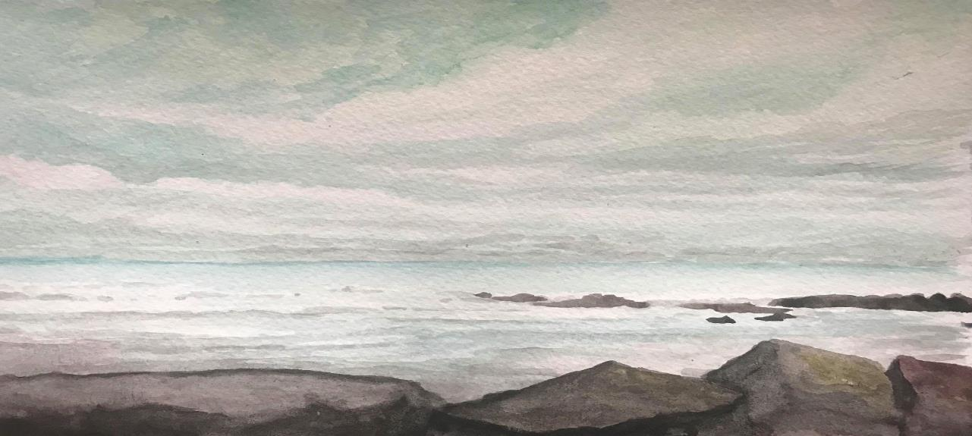
Thanks & Questions
mconsalvo@gmail.com|about.me/mconsalvo|@miac
andy@mail.rit.edu|andyworld.io|@ritigm1

Slide 22
MULTIPLE WORKS IN PROGRESS
Consalvo, M., & Phelps, A. (2019). Performing game development live on Twitch. Presented at the Hawaii International Conference on Systems Science, Maui, HI.
Consalvo, M. (forthcoming). Kaceytron and transgressive play on Twitch.tv. In K. Jørgensen & F. Karlsen (Eds.), Transgressions in games and play. Cambridge, MA: MIT Press.
Phelps, A., & Consalvo, M. (2018) “Live streaming game design & development: A glimpse behind the mystic curtain with pedagogical possibilities” at The InterPLAY of Game Studies and Game Design, 2018 NCA Preconference, University of Utah. S Orme, University of Suffolk. National Communication Association 104th Annual Conference, Salt Lake City, Utah. Phelps, A., Consalvo, M., and Egert, C. (2018) Development Streaming as a Pedagogical and Community
Strategy for Games Education. Workshop on New Research Perspectives on Game Design & Development Education. CHI PLAY 2018, October 28, 2018, Melbourne, Australia.

Slide 23
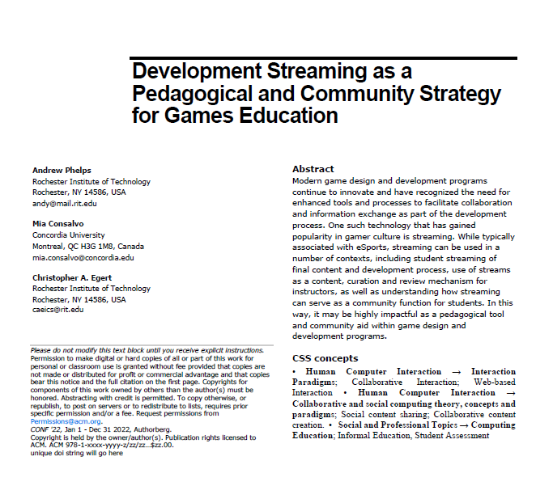
FUTURE WORK: EDUCATIONAL POTENTIALITIES
A first use of developer streams is for the instructor to use the technology to stream themselves performing various tasks and activities.
Second, there may be significant value in having students stream their own creations either as a form of ‘well played’ exercise, or simply as a walkthrough and talk-aloud critique of the project they have delivered.
Third, along with streaming final games and prototypes, having students stream their own development work to then examine and reflect on it could be incredibly valuable.
Fourth, having students stream their own work and development process can surface such work across an entire student body.
Fifth, development streaming has the potential to engage students in a wider community that extends substantially beyond the campus.
Finally, it may be useful to explore having students essentially “cross the streams” to help acclimatize students in a given role with their counterparts in other majors or areas of a curriculum.

