Slide 1
Andrew Phelps
Founding Director, RIT Center for Media, Arts, Games, Interaction & Creativity
Professor & Founder, School of Interactive Games & Media
CEO, MAGIC Spell Studios, LLC
Fellow, RIT School of Individualized Studies
Rochester Institute of Technology

Slide 2
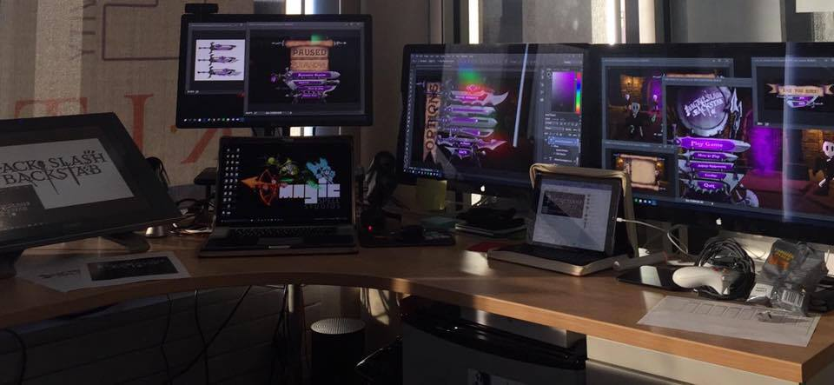
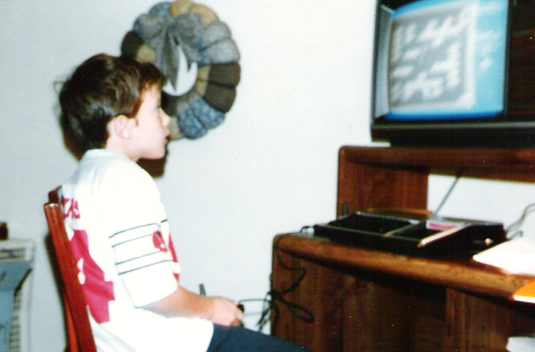
Hi, I’m andy. I make things.

Slide 3
Welcome “friends”
An evening of what we did
Where we succeeded
Where we failed
Lessons for the future
Q&A
No closet skeletons

Slide 4
A “NEW” KIND OF UNIVERSITY RESEARCH CENTER, LIKE NO OTHER ANYWHERE…
University
RESEARCH
Commercial
PRODUCTION

Slide 5
Lots of public success
FIRST graduate course in games at RIT
FIRST undergraduate course and concentration in game design and technology
FIRST degree program in the northeast in game design & development
FIRST DeptSchool of Interactive Games and Media
FIRST ever of its kind public-private partnership in the MAGIC Center
FIRST university to ship on XBOX One / 1st party channel
Lots of other firsts wrapped up in there.
HUGE outsized effect on university brand and public engagement

Slide 6
Lots of private failure
We do things differently and that creates friction
We pride ourselves on different values and criteria than other portions of the organization
What we think is important is often under-valued and unrecognized or under-appreciated
What we think is not important is often over-valued and incentivized in ways that break morale and engagement
We do not see our work as work. If we do, then we’ve failed. And this sometimes happens.
We are often afraid, often feel alone, often feel unsupported, and often feel adrift.
Angry birds is the 52nd game by that group. Fifty. Second. MAGIC is on its third reincarnation.

Slide 7
The M is for Messy

Slide 8
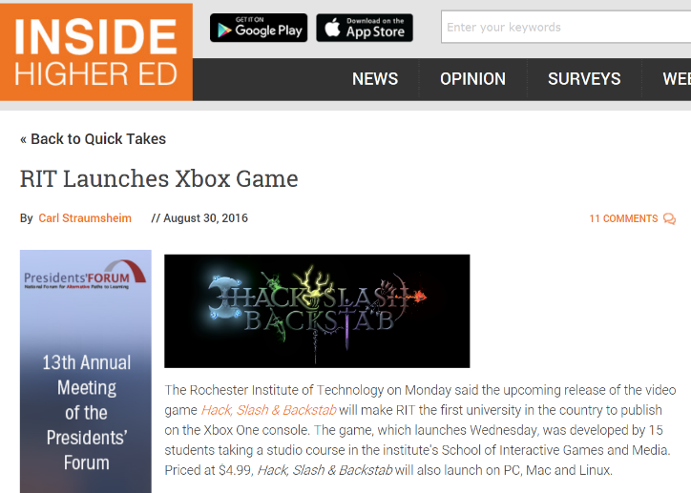
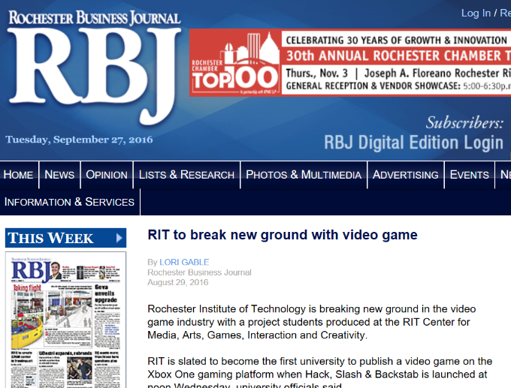
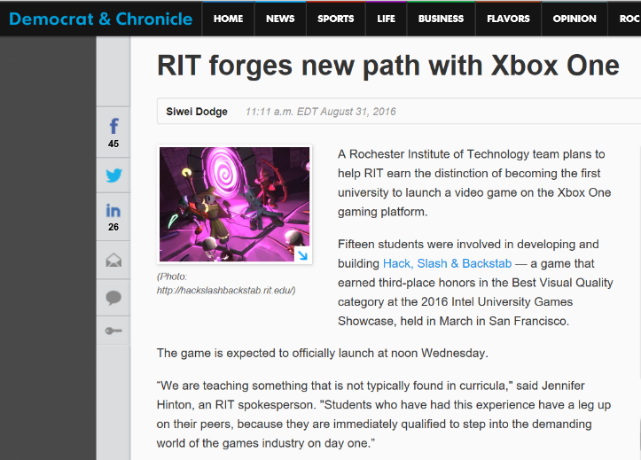
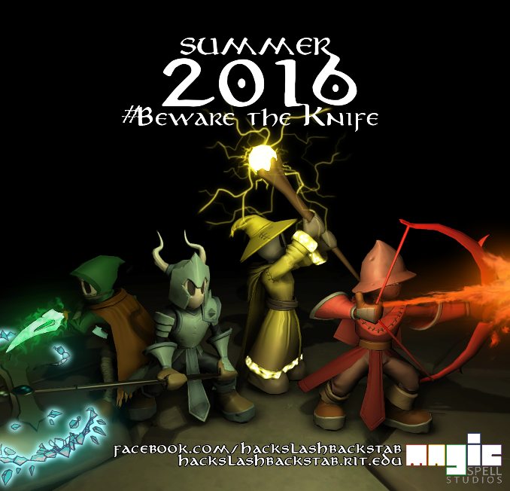
What is Hack, Slash & Backstab

Slide 9
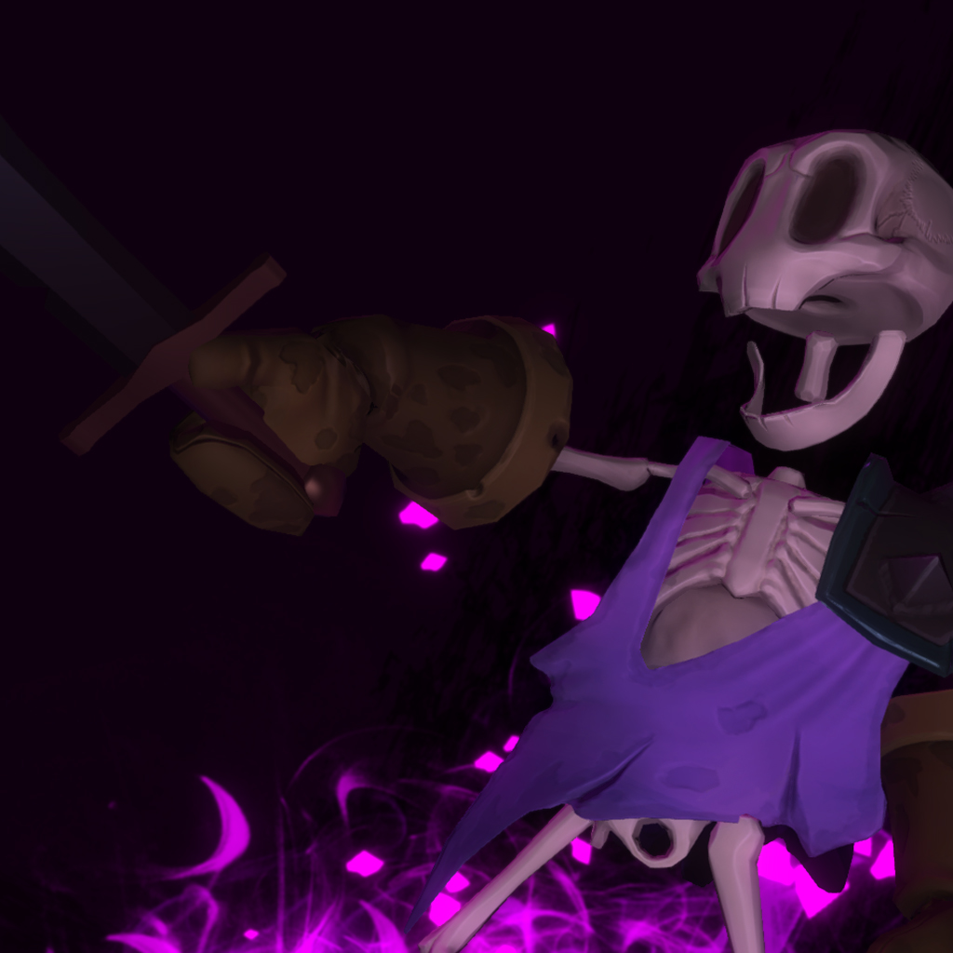
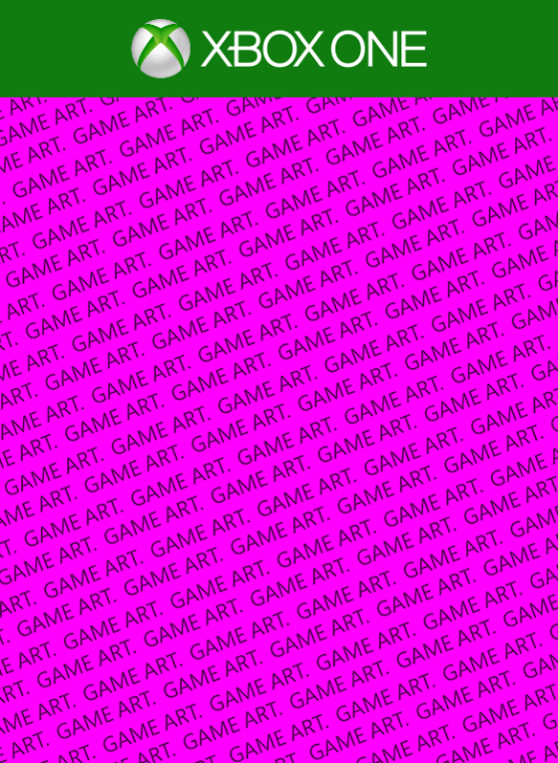
You Should Have Heard About It Already
#PrettyInPink
#BewareTheKnife
IMAGE:Molly Ringwald (not Jennifer Hinton) in ‘Pretty in Pink” © 1986
Retrieved via Google 2016

Slide 10
PART I: Where Did This Come From, and What Did We Actually Do?

Slide 11
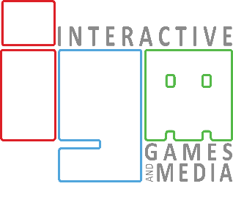
A Betrayal at Kronisano
IMAGE: ‘Game of Thrones’ promotional image season 4, © HBO. Retrieved via Google 2016

Slide 12
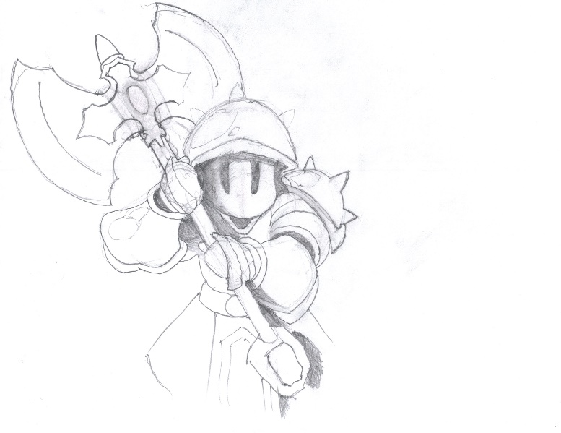
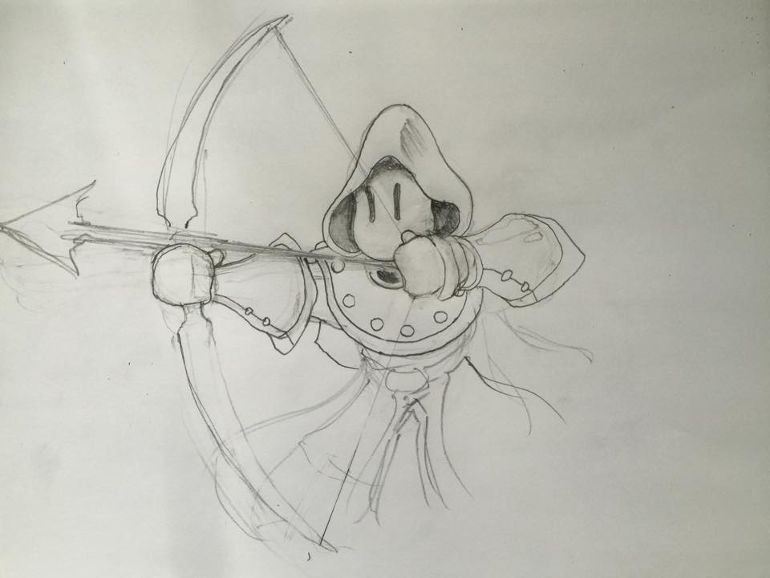
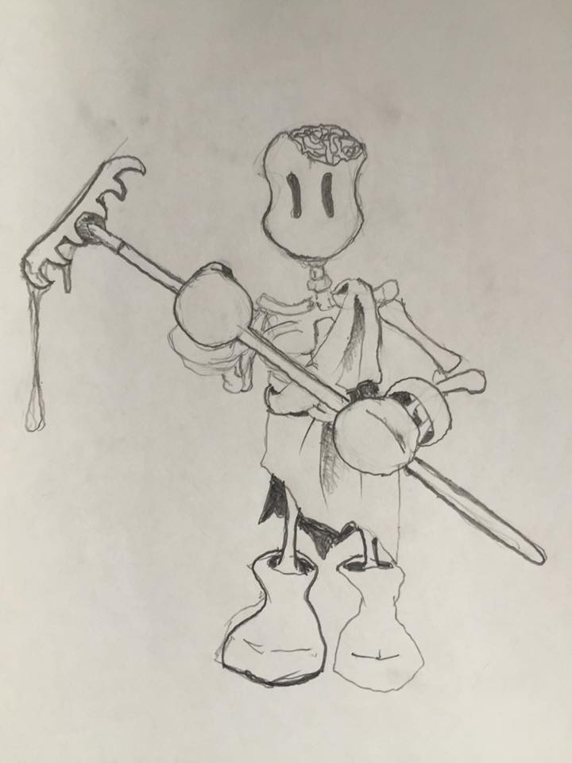
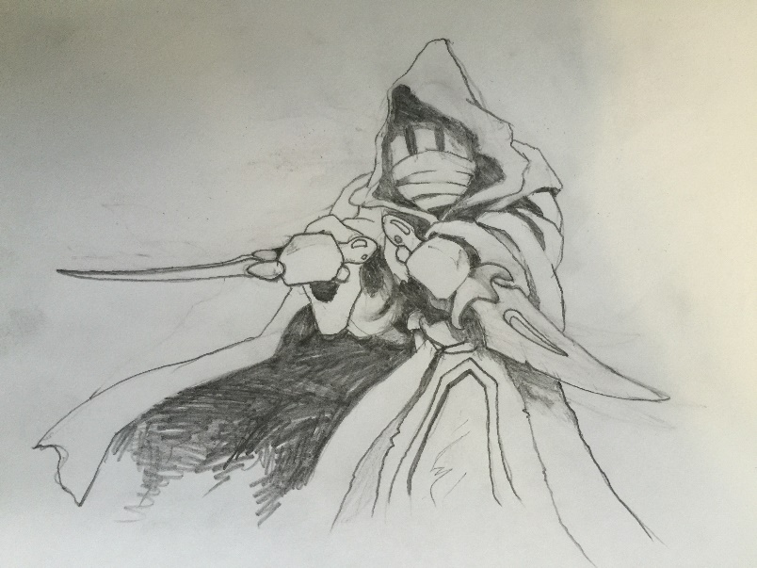
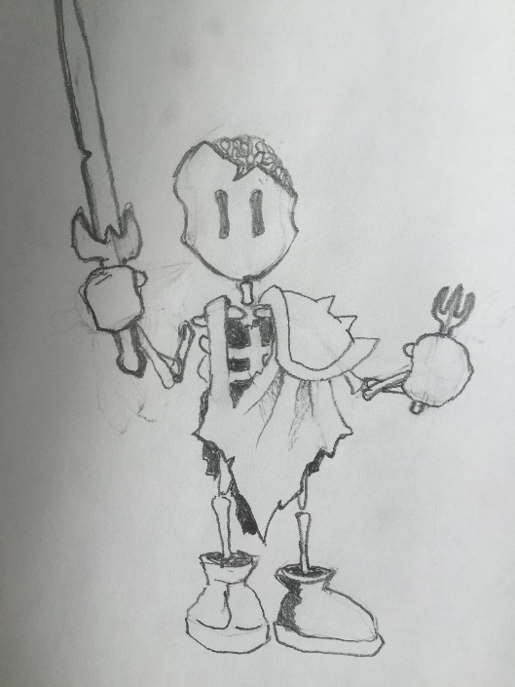
So Andy did the one thing he always does:

Slide 13
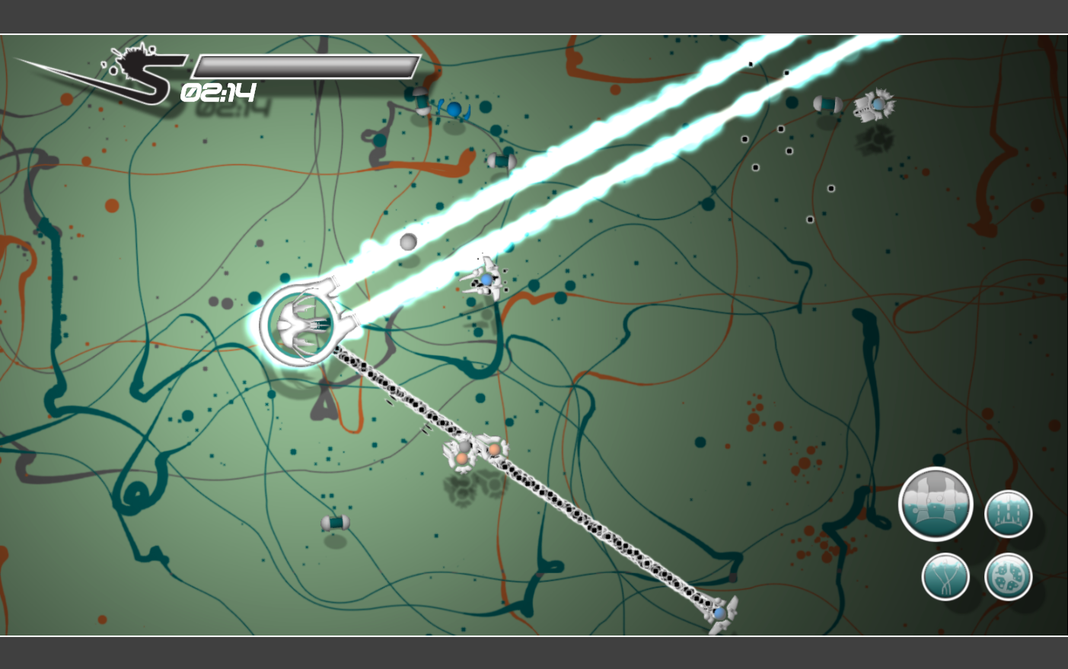
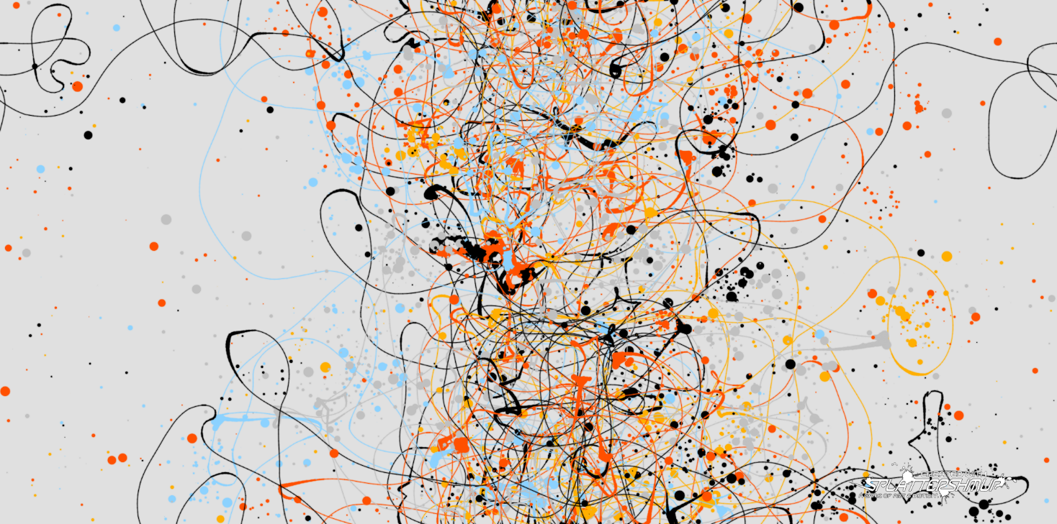
A note about “Art Games”
They are personal, by definition.
They are resonant with others only if you can broaden the experience.
At MAGIC, I have a particular interest in “experiential educational” games.
And with this game (HSB) I had something to say that wasn’t particularly kind, even if universally true

Slide 14
SUMMER: Pre-Production, Thinking, Planning, Sketching. PITCH DAY 1 of FALL CLASS

Slide 15
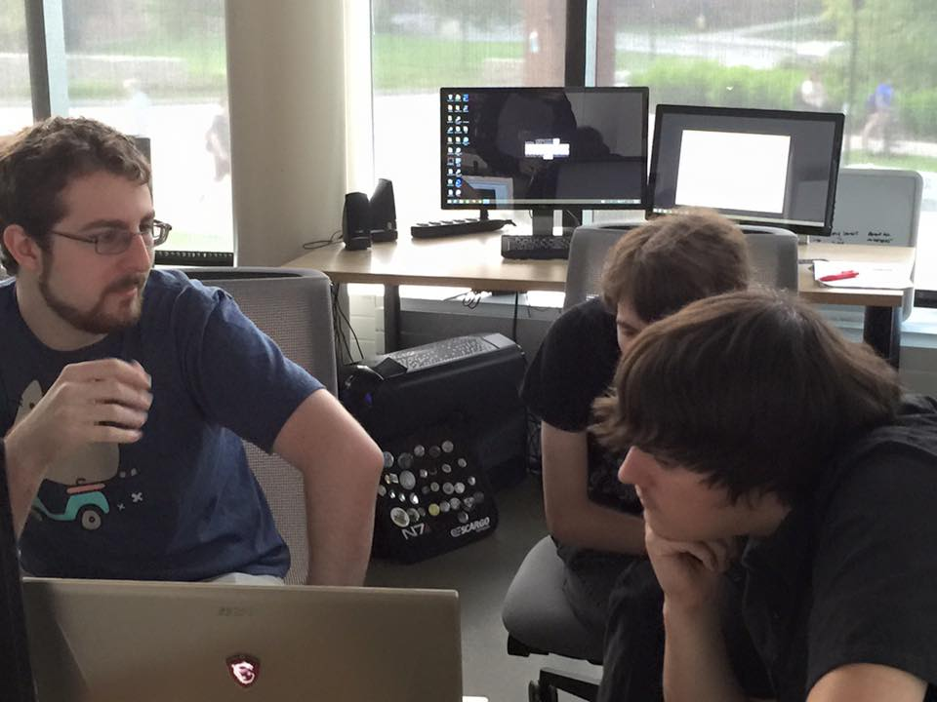
!(only) A Class Project
Right on the heels of success and failure of Splattershmup
We wanted to do something AMAZING, right from the start
Went and ‘background recruited’ some folks with not much success
Worked ‘the system’ as best as possible – custom time and lab
Hired our first F/T production manager

Slide 16
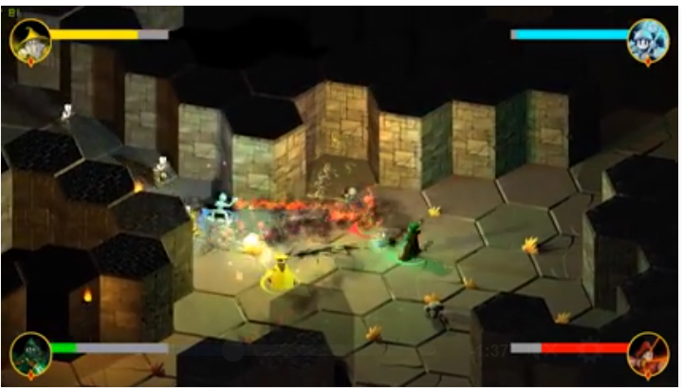
In-Class Schedule
Challenge design early
Pushed for playable ASAP – Week 2. Week 3 was the first real one.
Playable of core concept, mechanic & “story”
At that point ‘oh hey, this is weird and fun’
Continued ‘we should bounce back and forth in these modes repeatedly” which never really died, but never really made it in
Strategically, it’s not to your advantage to throw people under the bus early, so WHEN becomes an interesting moment

Slide 17
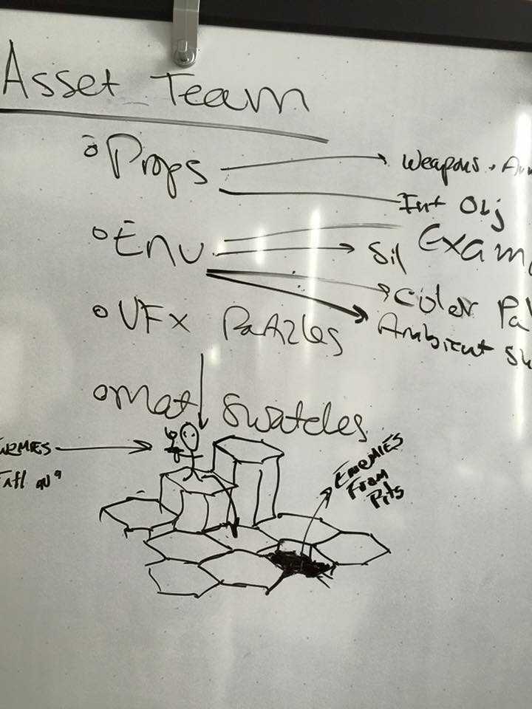
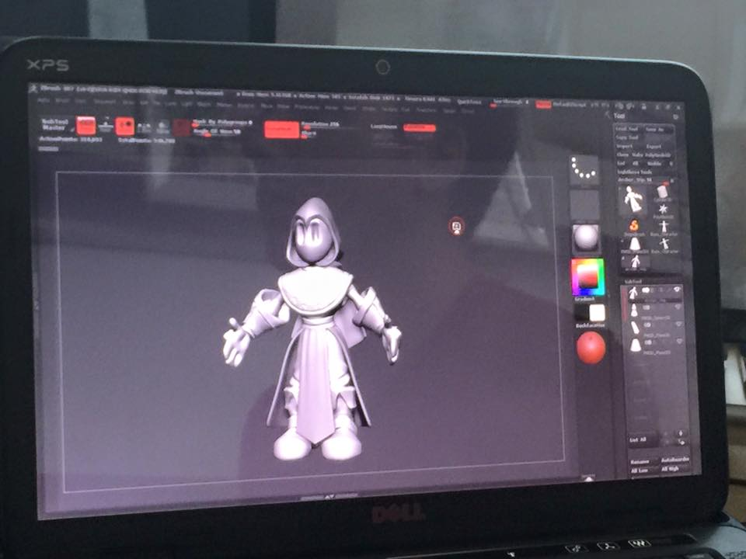
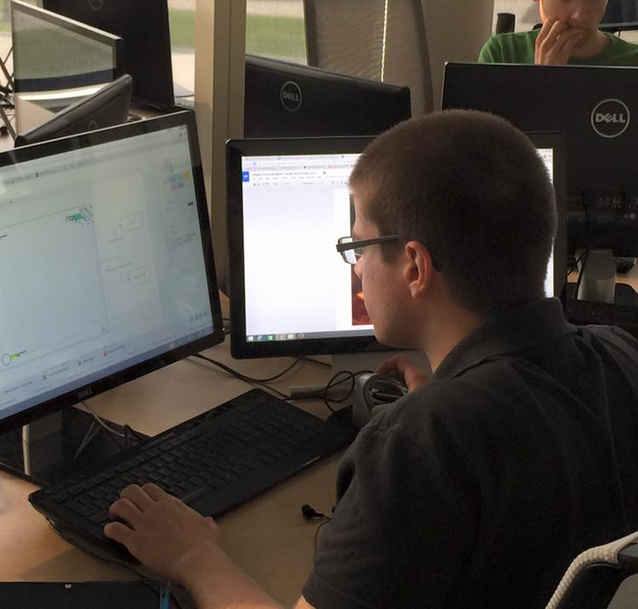
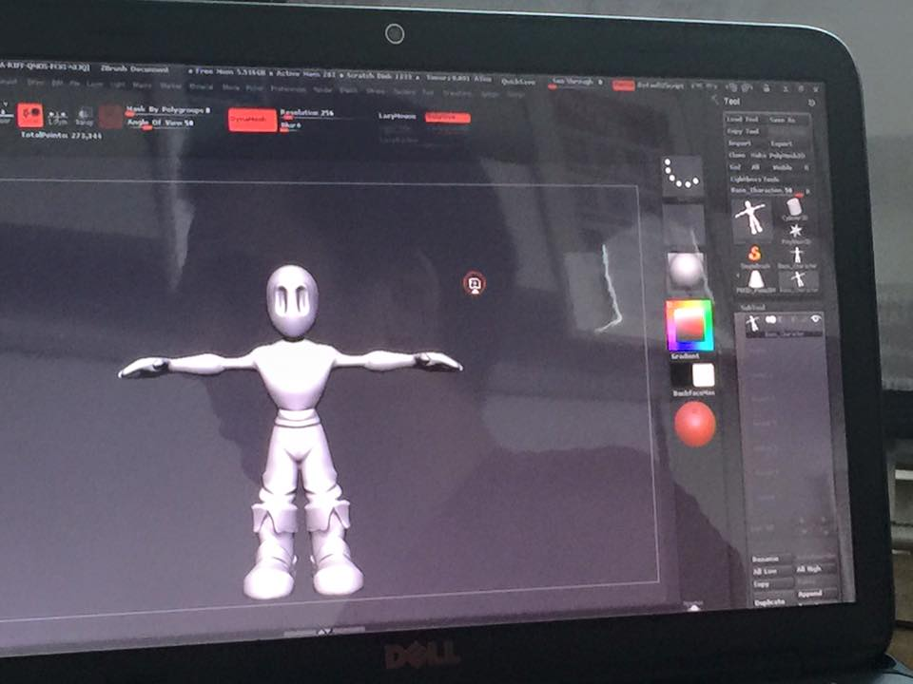
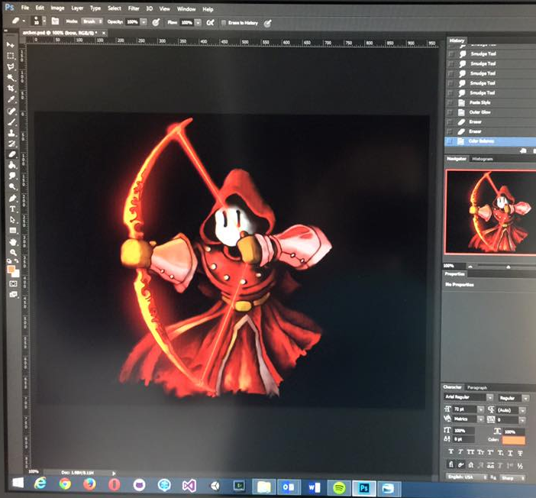
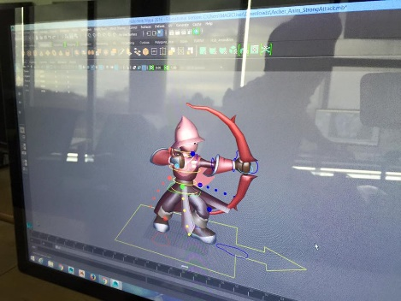

Slide 18
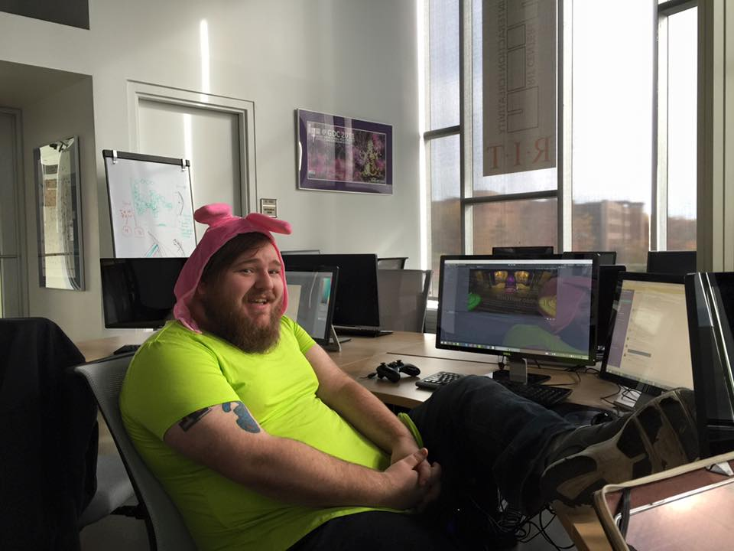
In-Class Schedule
Mondays were wrap up and completion
Tuesdays were merge and correct
Wednesdays were present / crit / feedback / and sprint tasking
Wednesdays after class were team lead meetings
Thursdays -> Sundays were core production
Fridays were work days with Q&A, and sometimes playtest
M/F were when Aaron and I had our hands on it most. Every hour of every day was when Rob had his hands on it.

Slide 19
Structure & Schedule
ANDY
Art schedule was fixed at about week 4, for the bulk of the semester (character and anim every 2 weeks)
Dev was more fluid, need based, iterative for specific features & systems... but still time-tasked
EVERY WEEK ELEVATOR PITCH
now we all understand it better!
CTO
OPERATIONS MANAGER
CREATIVE DIRECTOR
COMMUNICATIONS
OFFICER
PROJECT MANAGER
ART TEAM
AUDIO TEAM
DEV TEAM
UI/UX TEAM

Slide 20
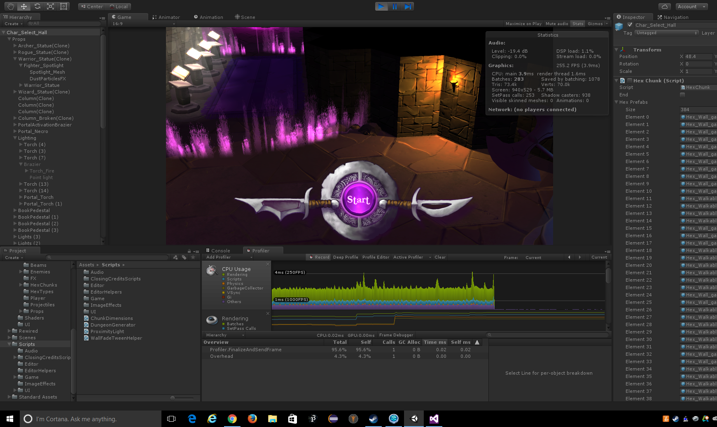
TOOLS & TECHNOLOGIES
Unity 3D – yes it’s a ‘unity game’
Google Docs – 28GB of Google Docs
Magical, Rewired,
iTween, and Closing Credits
Z-Brush
Autodesk Maya
Photoshop and Gimp
GitHUB
Slack (OMG THE SLACK. GET THE SLACK. BE ONE WITH THE SLACK.)
A whole host of others we used along the way for various little bits and pieces of idiocy. I counted 22 at one point.

Slide 21
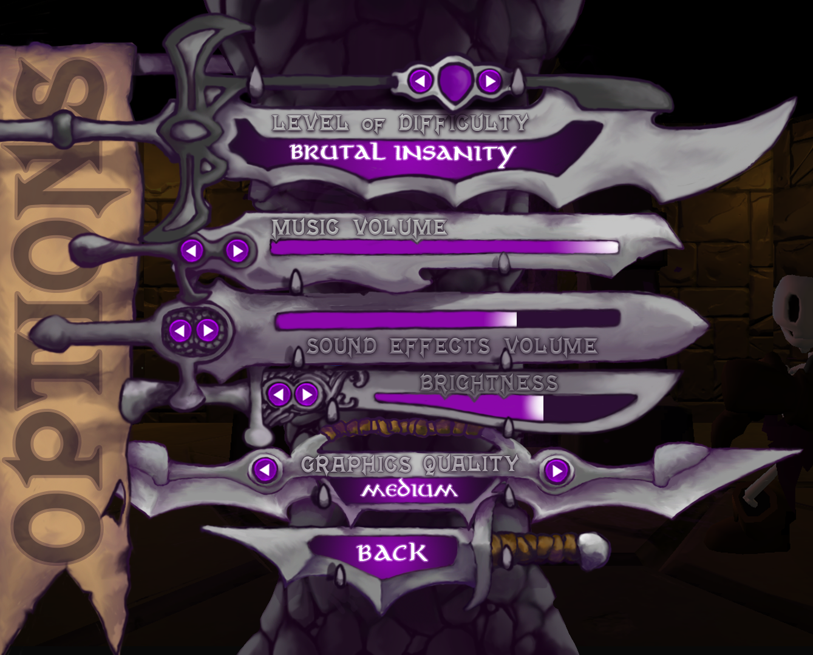
What we did, and didn’t do
Tweaks, options etc
Friendly fire on/off
All that work about proximity, complicated systems that were scrapped/simplified
Options – twinstick (nope)
Heavy Attack – didn’t have to be charged so why use light attack?
‘charging system’ – hard to illustrate
Difficulty – balance and replay, balance and replay
Inventory...

Slide 22
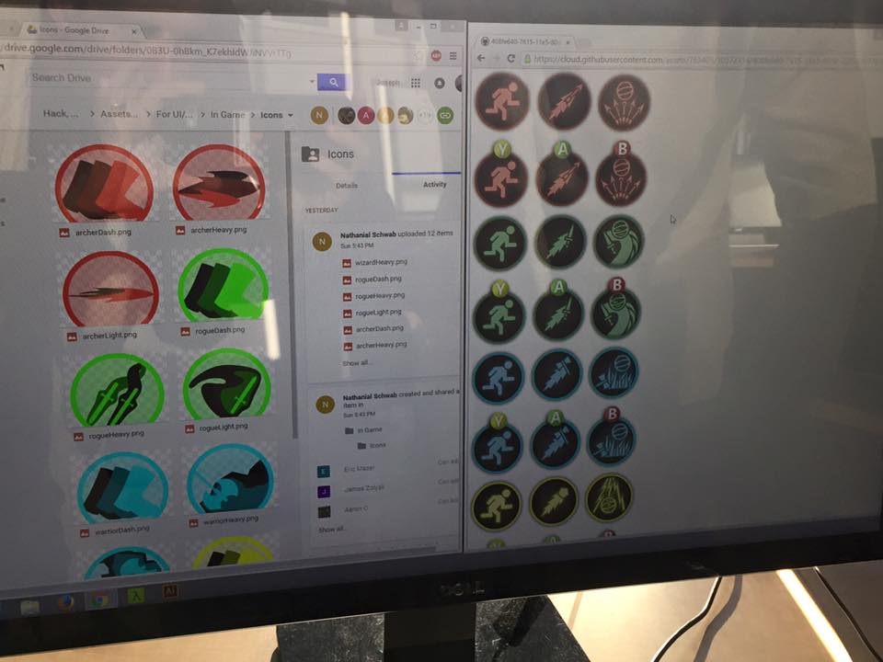
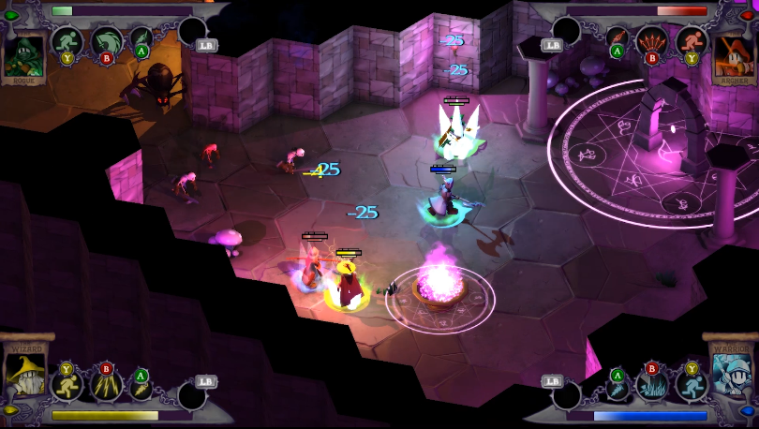
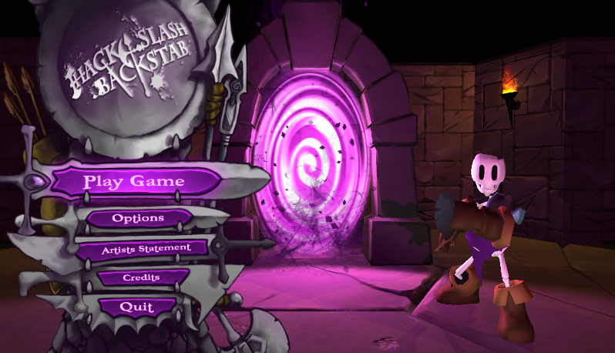
More of what we did and didn’t do
Health bars, in corner, by color, week 1.
Icons over and over and over again
State manager (from hell)
How to show light, heavy, dash well
Hexagon world was an early design decision that we wouldn’t budge on.
Last minute little player and enemy health bars / “floaty damage numbers”
Visual quality issues - no real skilled 2D artists
So Andy and Aaron did it.
Often we try to fill in gaps where we don’t have the students or skills to fit
This also moves the project to ‘ours’ and away from ‘us and them’

Slide 23
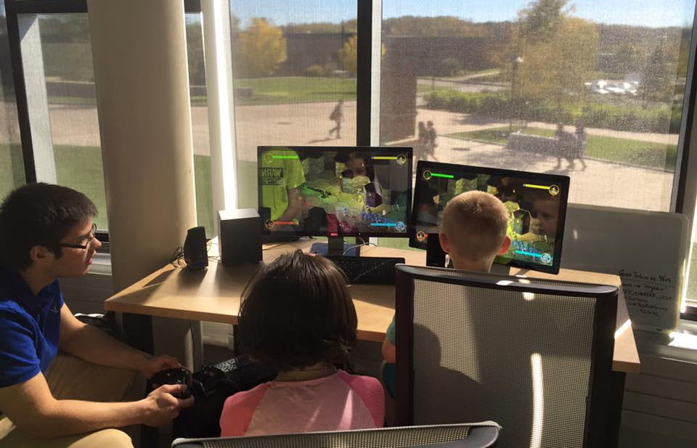
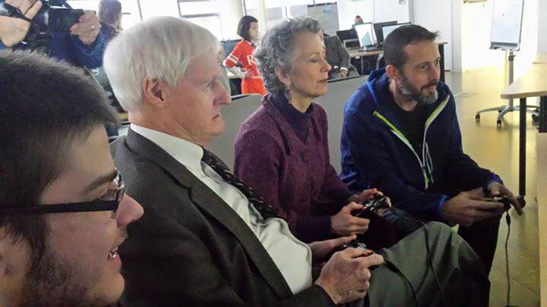
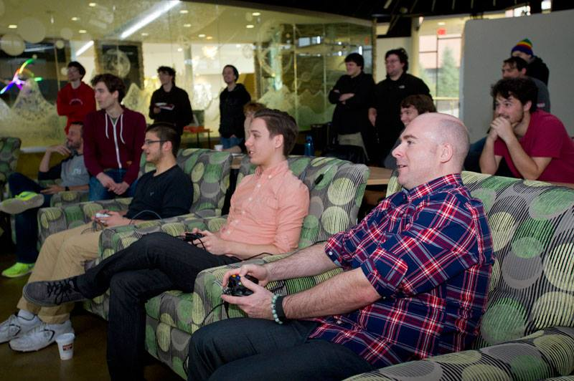
PLAYTESTING (LOTS AND STILL NOT ENOUGH)

Slide 24
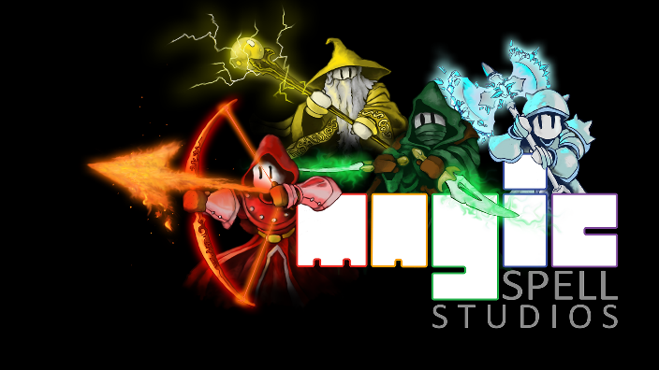
AT THE END OF THE SEMESTER, WE HAD A BASIC PLAYABLE GAME.
No achievements
No platform integration or testing
No real bosses
Very few items
Very few props
Lots of UI bugs
At that point, it was reviewed for viability, and failure was no longer an option. We were going to publish it. Same bar internal & external.

Slide 25
IGME RESEARCH STUDIO
INTERSESSION JAN 2016
SPRING SEMESTER 2016
SUMMER 2016
JAYSON
BRYCE
ERIC
TIMOTHY
BRANDON
JIM
JOE
THOMAS
NATHANIEL
ALEX
BRANDON
TYLER
ZACHARY
DEREK
BRYCE
GAME LAUNCH !
ANDY [ split time, CEO ]
CHRIS [split time, CTO ]
JENN [ split time, CCO ]
BRENDA [ split time, OPS ]
AARON [ part time, CD ]
ROB. [ full time ]
ROB. [ full time ]
ROB. [ a little bit ]
ERIC. [ full time ]
JIM. [ pinch hitter ]
JAYSON. [ full time ]
JOE. [ a little ]
JIM. [ full time ]
ERIC. [ full time ]
JAMES. [ full time ]
JOE. [ full time ]
ERIC. [ full time ]

Slide 26
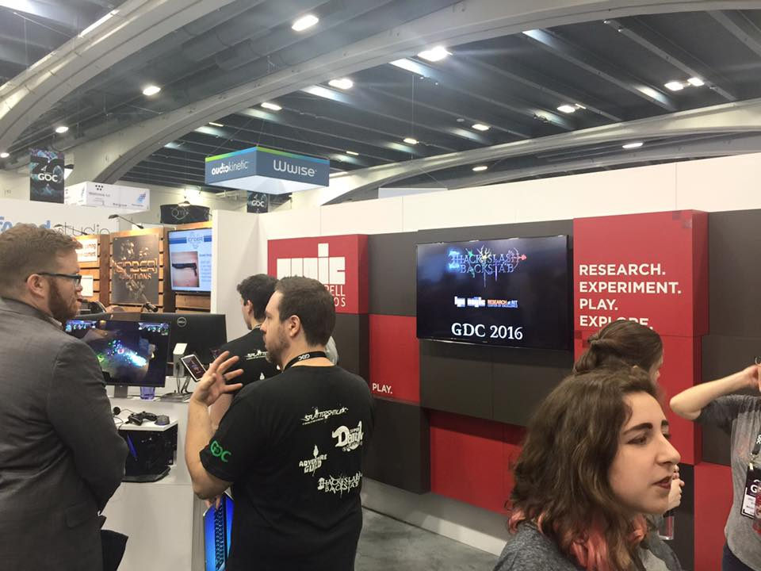
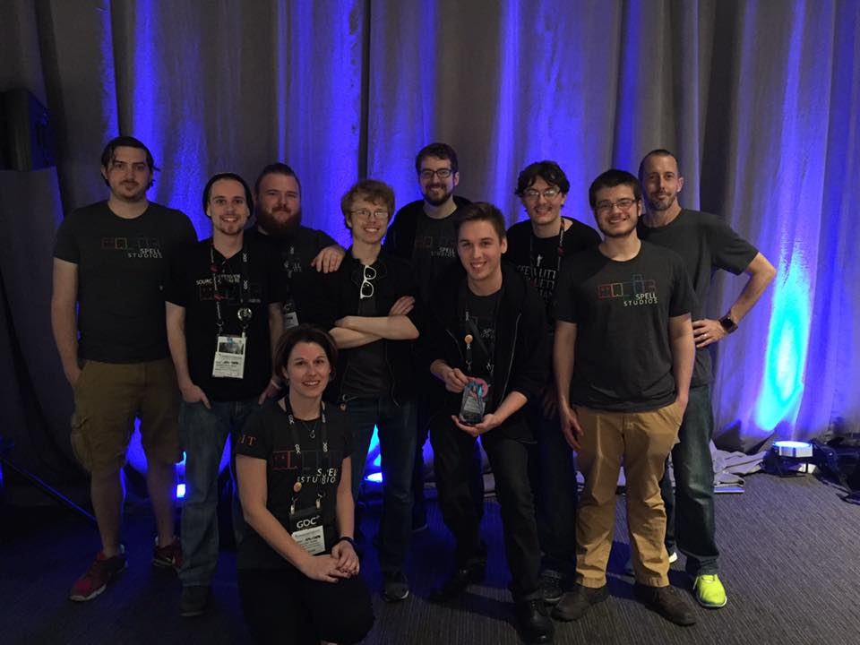
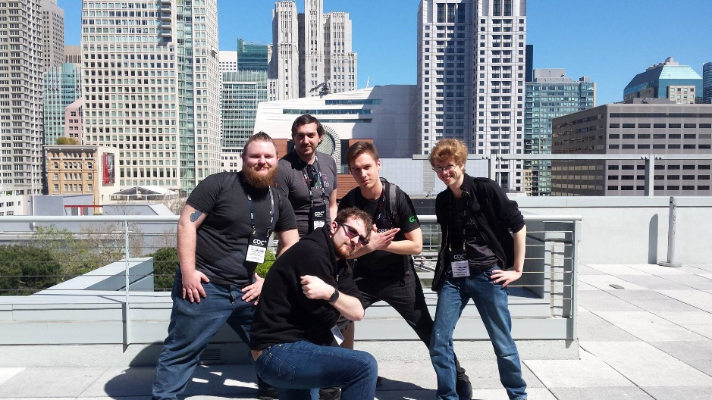
That Intel and GDC thing

Slide 27
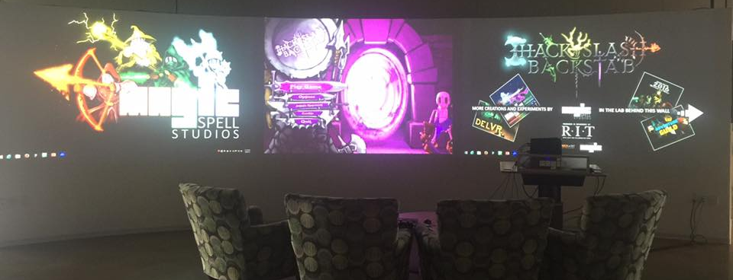
Those other little ‘on campus’ events…

Slide 28
INTERSESSION (DOWN IN THE STEAM TUNNELS)
A month of full time, no distractions worked wonders. But we could not have STARTED that way. It was carrying through on momentum.
AND THAT LOOKED GREAT. AND WE WERE HAPPY. AND WE RAN FACE FIRST INTO THE WALL OF PLATFORM AND CERT.
IMAGE: Real Genius character ‘Lazlo Hollyfeld’.
© 1985. Retrieved via Google 2016

Slide 29
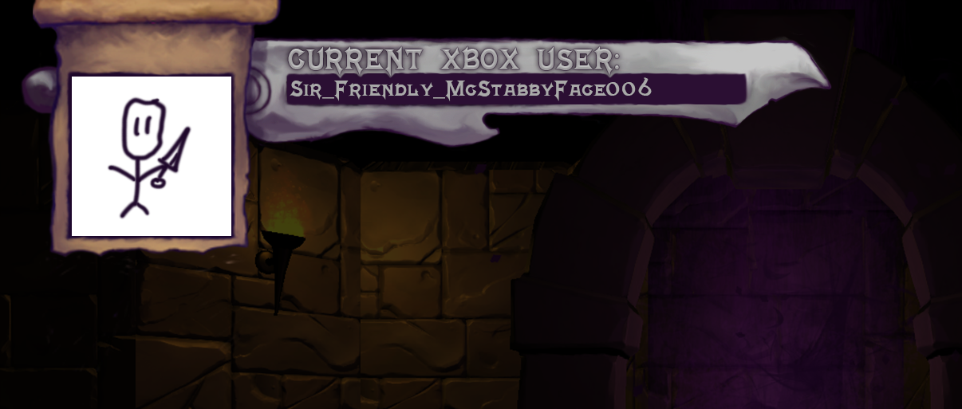
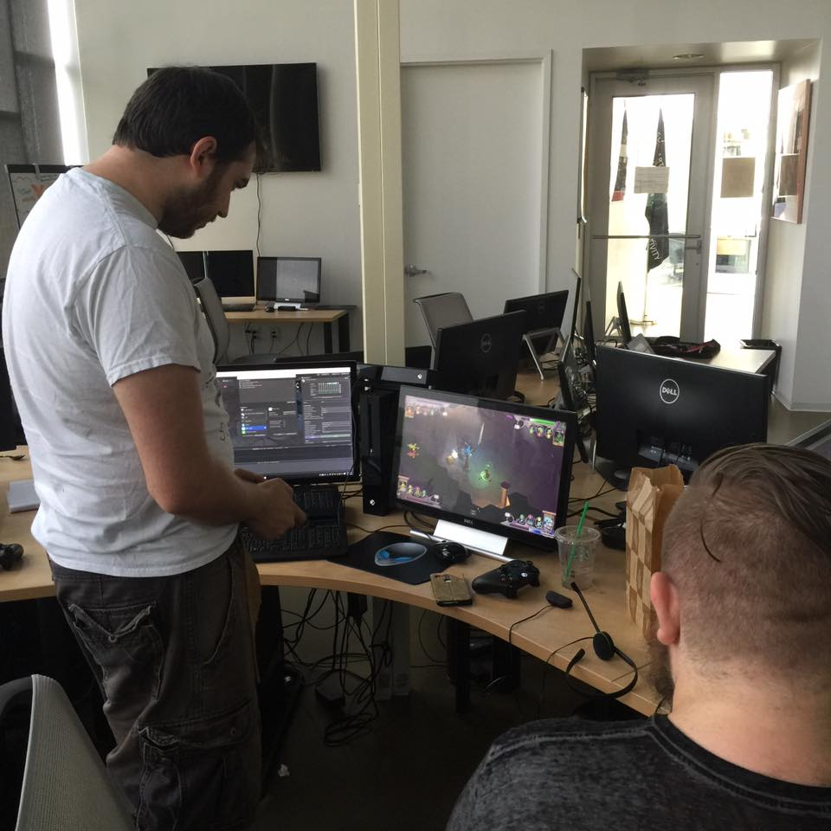
Ran on XBOX for 1.5 seconds and BOOM.
Polish and platform took as long as the ‘meat’ of the game.
we didn’t know what we were doing (1st time)
the game we made had no real overlap with the way platforms think about users
that’s just the way it is.
Could have pushed to XBOX earlier and often – but that would have slowed the class down (only 16 weeks! What has most value the first 16 weeks?)

Slide 30
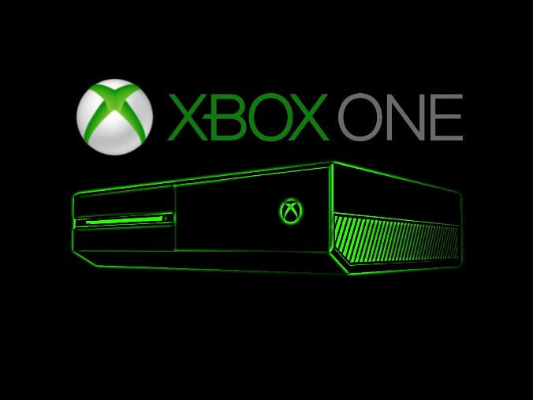
Write Once, Crash Everywhere
SOME versions of Unity worked with our input plugin. SOME worked with our game. And SOME worked with the XBOX.
~19 versions of Unity, point release by point release.
Had to file an exception to use an ‘old’ version – somewhat near where we started the class.
In the future, will have to ‘roll forward’ on some releases? (Should have been testing continuously from back to current to beta…)
Build, upload to store (hours), pull down from store (hours), crash, debug, try again. About a 2 day cycle, so lots in parallel.
HUGE implications for IGM / MAGIC building imaging schemes…
“…fill this in later…”

Slide 31
Part II: OMG We Released A Game !!!1!1!one

Slide 33
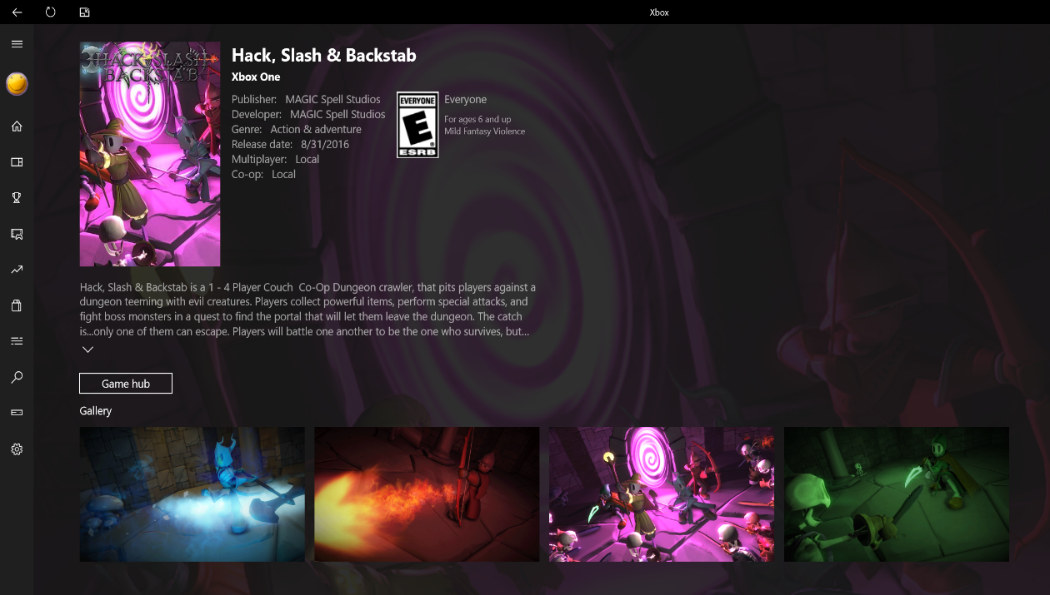
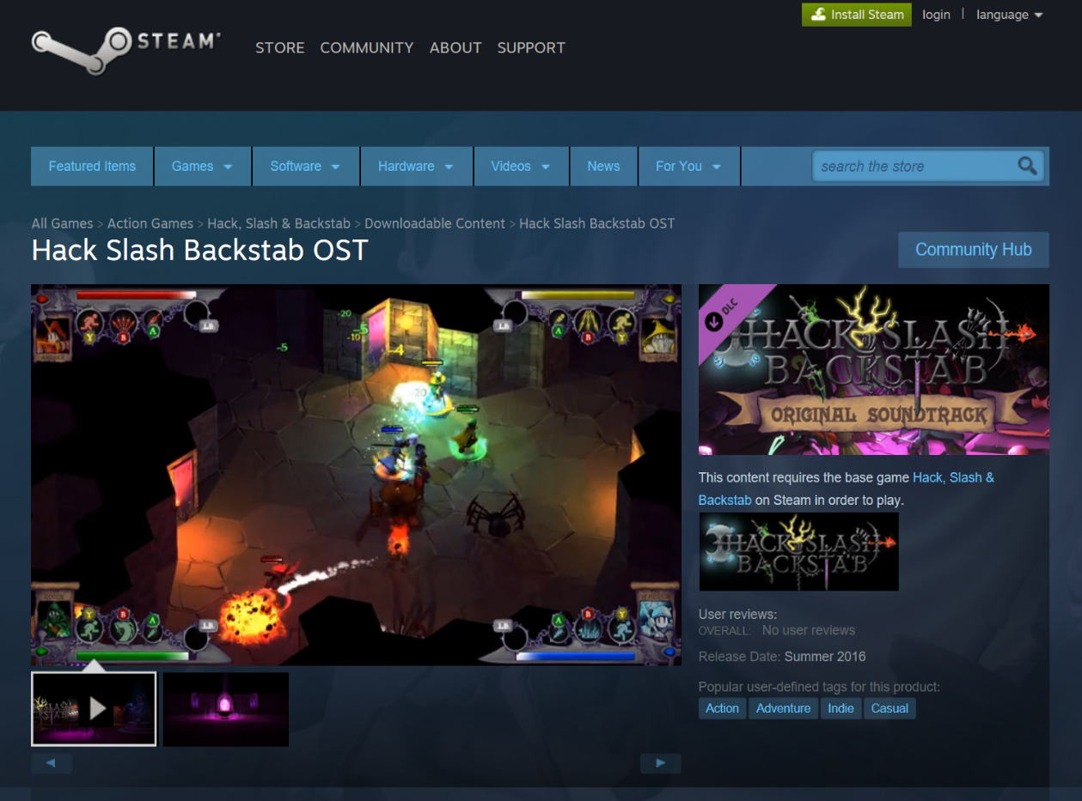

Slide 34
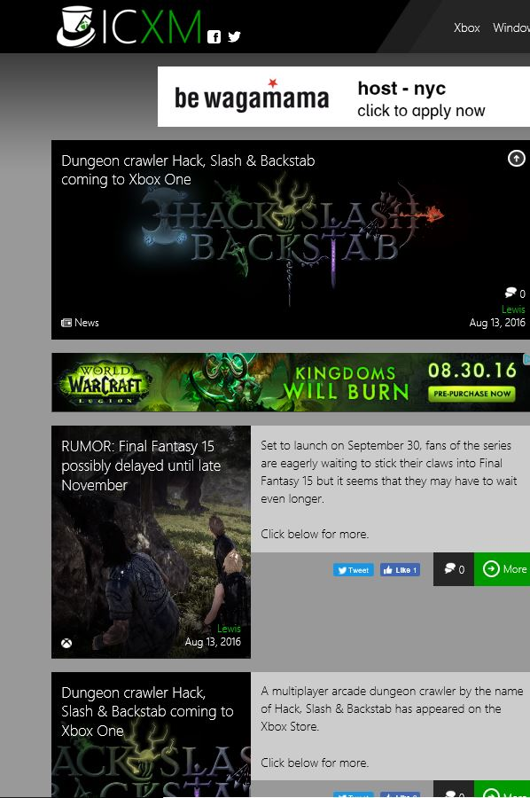
Everyone Said It Couldn’t Be Done

Slide 35
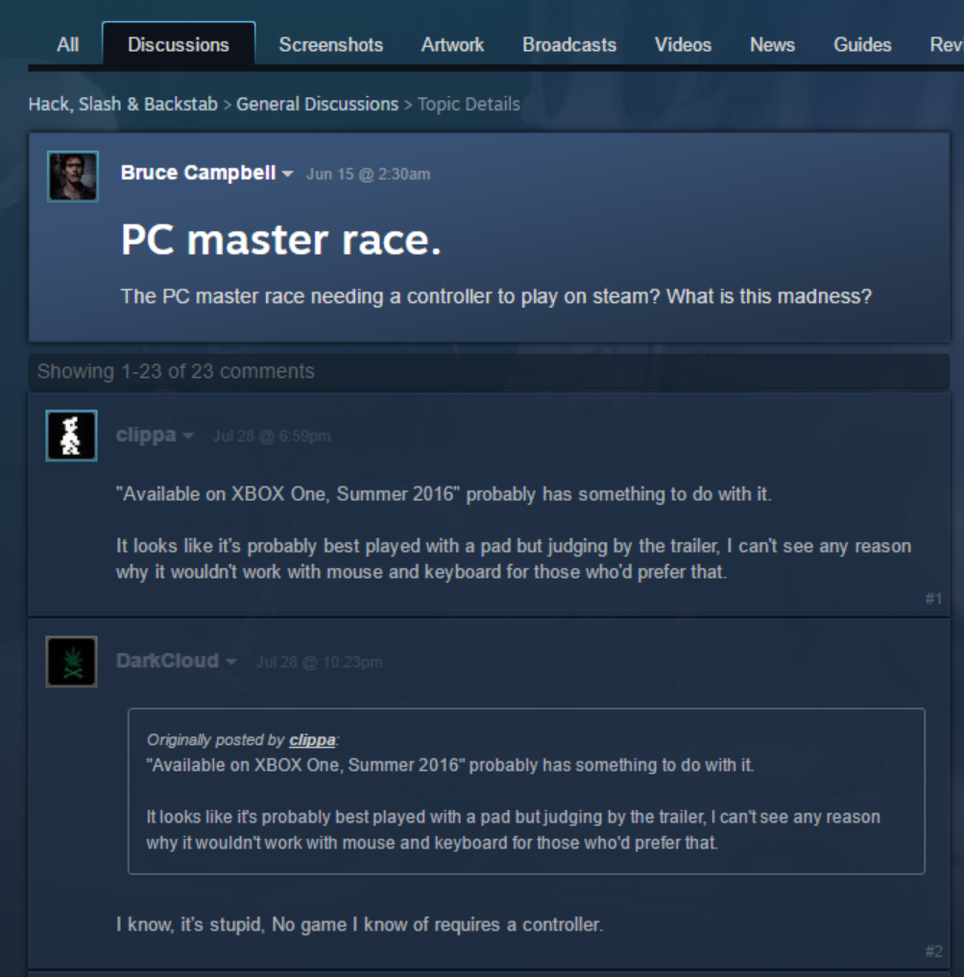
Public Praise, Accurate Critique, and Fanboi Flames, All-In-One
It’s not a single player game
It’s not a PC game
It’s not really even a “dungeon crawler”
“it’s an arcade game on steam, not a “steam game.”
It is a throwback to Andy’s childhood, because of earlier reasons.

Slide 36
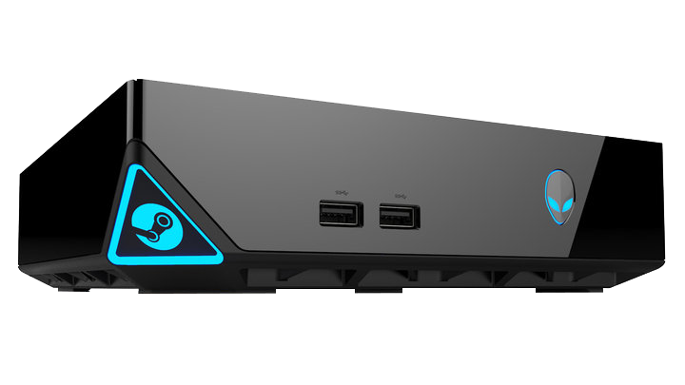
Oopsie. We Bought In on That Which Was Not There

Slide 37
We are not this game.
IMAGE: Diablo III by Activision | Blizzard. Multiplayer. © Image retrieved via Google 2016.

Slide 38
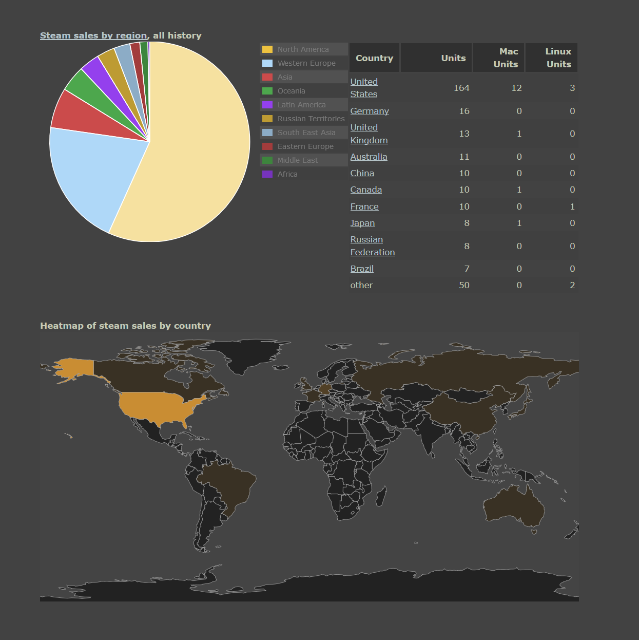
Sales and Data Things
About 275+ on Steam / Humble (mostly falling off after initial spike)
About 1400 on XBOX to date (Still climbing – about 30-70 a day, avg 52)
Very different response, but similar geographic breakdown
No real surprise given localization support

Slide 39
See-Saw Breakdown
Stage 3: Profit
(Made about 9K so far)
Cost of Co-Ops
Misc. Platform Fees
Cost of Software
Cost of MAGIC personnel
#zeromarketingbudget
(Spent about 17K)
(which is more like 120K+)

Slide 40
PART III: Thoughts and Critiques

Slide 41
Proportion & Perspective
16 reviews on XBOX Live, evenly distributed 1-5, on a reverse bell curve
5 reviews on Steam, 2up, 3 down. (trend: more in game time = more positive review)
3 formal reviews 7/10, 5/10, 3/10.
A handful of really great, really hilarious, youtube and twitch plays. And some crap.
Hilarity on price point – everyone whines on PC, everyone praises on console. Which we expected. It’s the same price as a grande PSL.
IMAGE: Pumpkin Spice Latte promo image via Starbucks. © Image retrieved via Google 2016.

Slide 42
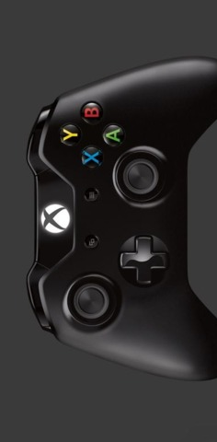
Input & Output
Should we have made it a twin-stick?
Maybe? You lose the purposefulness in PvP, but it’s easier to control…
More a modern game, less reference to the arcade
Easier for gamers vs. easier for (some) kids
Should we have released the single player mode at all? How better to describe it?
Accounts for most of the bad reviews
Accounts for most of the Steam sales (which are weak)
Accounts for decent portion of the ‘Y u no keyboard?’
But it is actually fun to practice, and achievement hunt

Slide 43
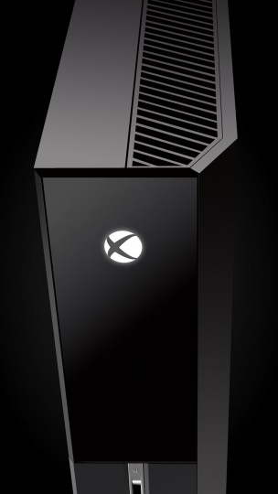
Everything Old is New Again
Designing on console is just plain different
Consoles are coming around again as a part of the ‘universal’ app process (really unfortunate we gave away the ports and process, new building design is an opportunity. It’s XNA all over again, only better)
Consoles are different because engagement context is different
Consoles could drive mass-VR beyond mobile (Sony, XBOne)
1st Party Rules from the Stone Tablets of Game Creation
Plus: Public Perception and Cache

Slide 44
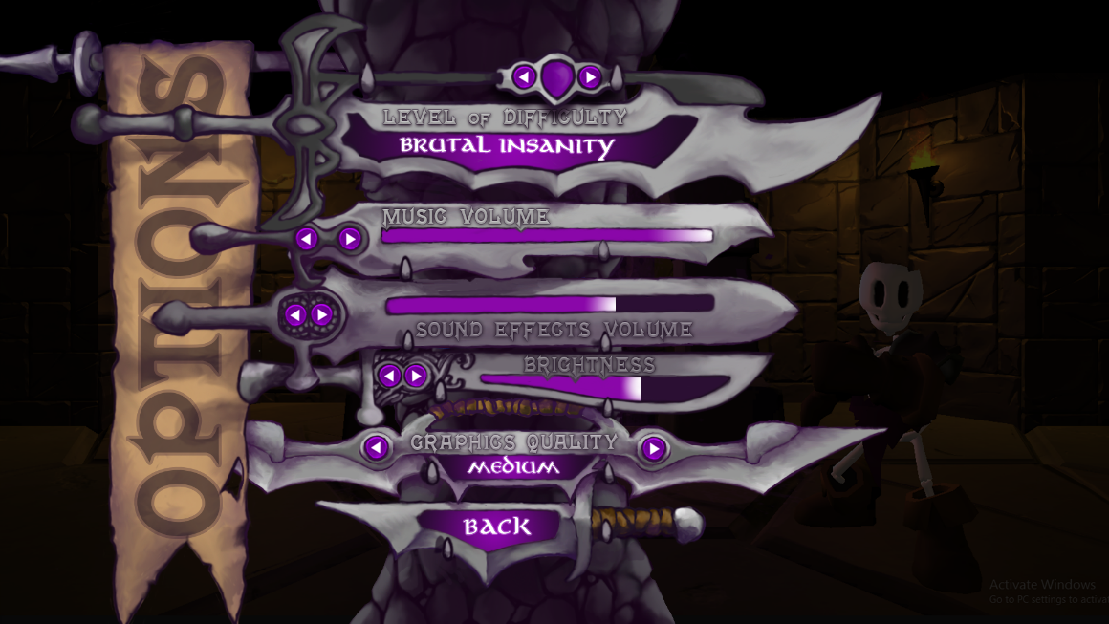
Hey. It’s Too Hard.
How could we have better surfaced difficulty slider, and where should we have started?

Slide 45
This Class Thing
Widely variable inputs (who signed up?)
Credit doesn’t scale to actual activity
Timeline is a constant battle, but also a help
Full-time PM (TA) was a huge lesson / leg up
Still wildly mis-understood by students (both name and content)
NOT POSSIBLE WITHOUT IGM & CIAS. NOT POSSIBLE WITHOUT MAGIC SPELL STUDIOS.

Slide 46
We Succeeded Through Teamwork
…In creating a game that speaks deeply about ways organizations break teamwork.

Slide 47
PART IV: An Eye Towards the Future

Slide 48
Where Do We Go Now?
1. #ZeroMarketingBudget
2. Formalize QA roles as a part of the course / co-op experience
3. Two-edged knife of ‘more student involvement in design process’
Isn’t ‘production’
Ownership of ‘someone else’s’ game
We do lots of other ‘student designed’ work, but is that this?
4. Anything bigger is impossible…. with the current structure…
IMAGE: Axl Rose of Guns ‘n’ Roses performs “Sweet Child of Mine”, Los Angeles. Image via YouTube 2016.

Slide 49
MOAR Firsts?
We were 1st to publish on the XBOX One platform, USC published this summer on Sony Playstation. We both published on Steam as the university, as did Utah.
I don’t intend to give up our lead. So what’s next….

Slide 50
A new game, a new development experience

Slide 51
Thank You
The MAGIC team
The incredible students and co-ops
Interactive Games & Media (IGM)
Sponsored Research Services (SRS)
Finance & Administration (F&A)
Paige, Daniel, Roen, Simone, Emma and Kalan
President Bill Destler & Dr. Rebecca Johnson
The hairdresser of Mr. Liam Middlebrook
AEL Colleagues
Darkwind & Workinman
All the Players and Fans

Slide 52
And Ashley, who got us cake
18 Months of the hardest work ever.
22 software packages
3 lab images | 2 v. Windows
@$*&@# Unity versioning
Hand cramps from Wacom tablet
Piles of broken code and UI “fixes”
Slack at every hour, all hours
The list goes on and on and on…
One great game, from one great team.

Slide 53
fin

Slide 54
Thanks & Questions
andy@magic.rit.edu | magic.rit.edu | @ritmagic

