Slide 1
Fake News Cycles: The Repetitive Design of Disinformation Games
GAMES+LEARNING+SOCIETY 2022 | UNIVERSITY of CALIFORNIA at IRVINE
Andrew M. Phelps
Professor of Human Interface Technology (HITLabNZ), University of Canterbury, NZ
Professor, Film & Media Arts, School of Communication, American University, USA
Professor, Computer Science, College of Arts & Sciences, American University, USA
Visiting Faculty, Department of Game Design, Uppsala University, Gotland Sweden
Program Director, Digital Screen Campus, University of Canterbury
Director, AU Game Center & American University Game Initiative
President, Higher Education Video Game Alliance
Notes:
Title image from https://www.bbc.com/news/technology-53176946 “Christopher Nolan hit film screens inside of Fortnite”

Slide 2
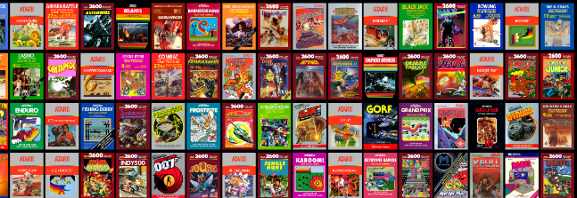
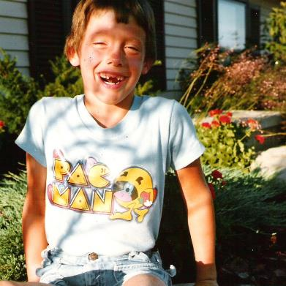
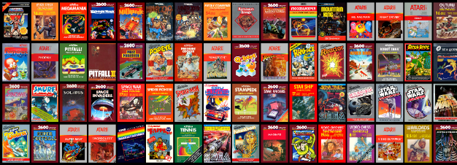
HI, I’m ANDY
I NOW collect academic titles and
positions for fun (BUT SOMEHOW
NOT PROFIT).

Slide 3
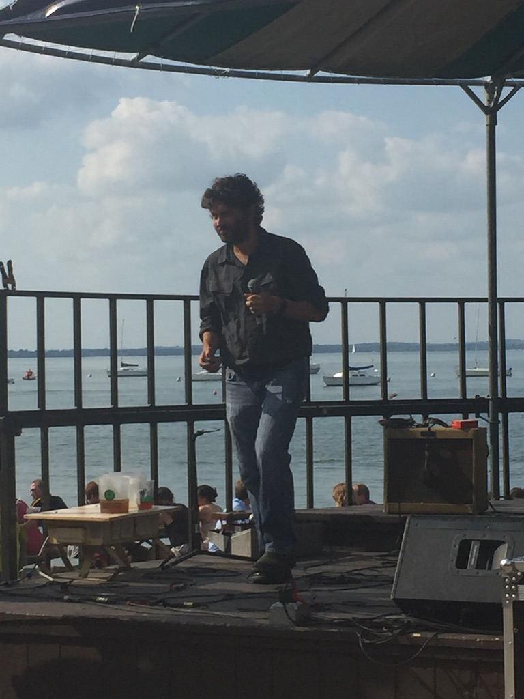
I MISSED YOU. A LOT.

Slide 4
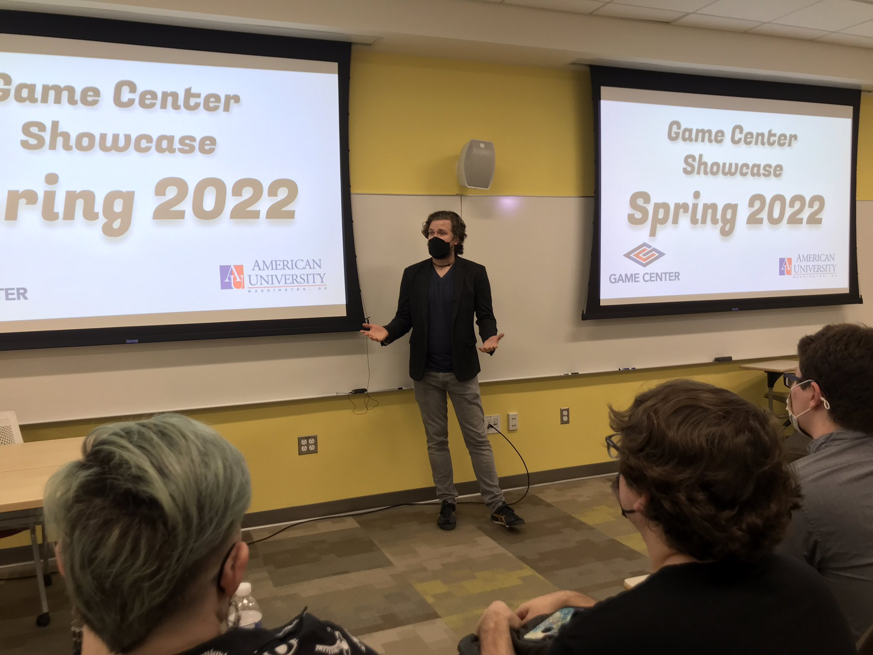
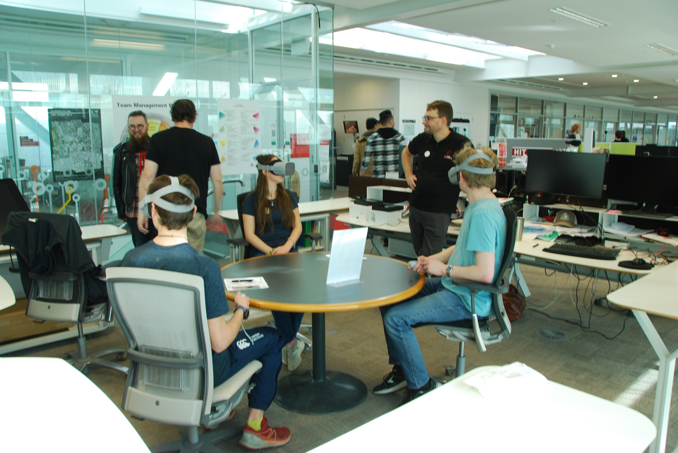
American University Game Center
University of Canterbury HITLabNZ

Slide 5
So this is… actually work with me and my MFA students (MOSTLY THEM)
Jocelyn Wagner, MFA
Andrew Moger, MFA

Slide 6
AND ITS… ACTUALLY WORK BASED OFF OF FRIENDS WORK ELSEWHERE
Mia Consalvo & Scott DeJong at Concordia University at mLab
Lindsay Grace at Miami University MFA in Digital Media program (and as Knight Chair of Interactive Media)

Slide 7
BUT WE TOOK A LOOK AS WELL
There’s predominantly 2 kinds of ‘fake news’ games!
Guess which news as fake
Play as a kind of ‘disinformation officer’ to ‘create’ fake news

Slide 8
HARMONY SQUARE AND ITS ILK
[…] tjhere has been some research done on the actual impact of these games, notably Harmony Square and Bad News (DROG, 2020; DROG 2018). Using data collected from these games, researchers concluded that the “inoculation” approach of both games was “effective at reducing some of the harmful effects that manipulative content can have on individuals” (Roozenbeek & van der Linden, 2020). Additionally, players were found to stay “inoculated” from false information far beyond just the immediate moments after playing, with the decay of player resistance being prevented by the administration of short “booster shots” (Roozenbeek & van der Linden, 2020; Maertens et al., 2021). This research shows that using games as a way to teach about dis/misinformation is a viable option in the drive to curb the spread of fake news.

Slide 9
Notes:
Lindsay Grace, Bob Hone, Maggie Stogner at AU Game Lab (before I got there)

Slide 10
TIMELINESS
Another pain point for current fake news games is their timeliness. Fake news content is ephemeral and always shifting, however the tactics used in designing and disseminating it appear to stay more consistent. Due to this constant yet ephemeral nature of dis/misinformation, we found that games that take a more allegorical approach (such as Harmony Square (DROG, 2020)) rather than explicitly using timely content (such as Factitious 2018 (AU Game Lab, 2018)) have a longer shelf life simply because they don’t have cultural timestamps.

Slide 11
What _COULD_ THESE GAMES BE? ( brainstorming with Mia )
1) a simple scrabble like word game where words have points and you have a goal of strengthening or weakening or changing a headline for maximum political effect but with the smallest number of changes,
2) a kind of “Among Us meets telephone” where you get to modify incoming and outgoing rumors a little bit to try to fool people downstream,
3) Mass Effect meets fake news, where you get a paragon/renegade morality meter depending on your choices,
4) an RPG where you are a Roger Ailes and all of the choices are horrible things,

Slide 12
What _could_ these games be?
5) a mystery game a la Phoenix Wright wherein you search media for clues, interrogate trolls on the witness stand, and call foul on their fake testimony,
6) a Roswell game where you must manipulate the media to make sure the aliens are continued to be seen as a hoax, and many others.
The design space need not be limited to “real world fake news”, to the categories that are dominant in the space today, nor the mechanics of either guessing or roleplaying.

Slide 13
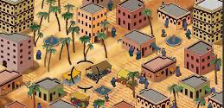
WE KEEP APPROACHING THIS AS AN EDUCATION OR PRACTICE PROBLEM. THIS IS PROBABLY WRONG
Notes:
Screen from ‘September 12’ by Gonzalo Frasca, as reviewed and ‘Well Played’ by Matt Weise at NYU. The point being, we keep wanting to ignore all the icky bits like switching costs and tribe and community etc.

Slide 14
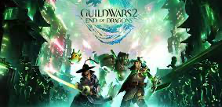
A Gentle INTRODUCTION TO POLITICS AND TRIBALISM

Slide 15
Oh, right, I live in dc. FUN TIMES.
Notes:
Image from https://www.theguardian.com/us-news/2021/nov/17/qanon-shaman-jacob-chansley-sentenced-capitol-attack-role

Slide 16
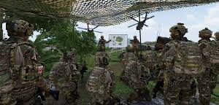
I MEAN, IT’S HAPPENING…
Notes:
This is ARMA 3 (video game) that was presented online as live footage of Ukraine (it was not)

Slide 17
Throwback to Guilt of the guildleader (GLS in 2011)

Slide 18
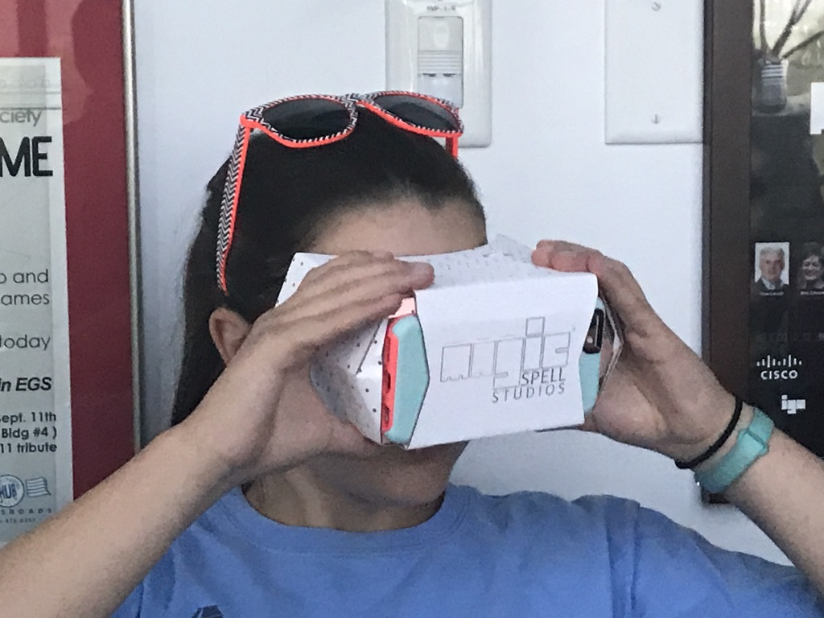
I know, LETS LAYER ON ALL THIS @)#$&*@)#(
IMMURSURVE !!!!111!!one

Slide 19
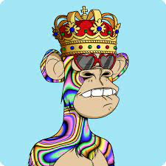
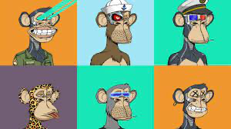
NEWS WILL BE SOLVED BY PROVENANCE?
Notes:
Image from https://www.oneclub.org/awards/youngones/-award/29007/wtf-is-blockchaina

Slide 20
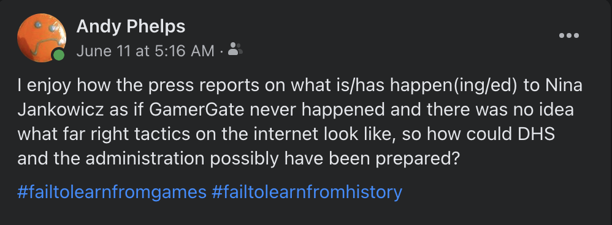
I MEAN, WE CAN’T SOLVE, UH, _ANYTHING_
Notes:
https://www.washingtonpost.com/.../disinformation-board.../

Slide 21
I HAVE NO ANSWERS, BUT A LOT OF QUESTIONS. AND I WANT BETTER GAMES THAT ACTUALLY ENACT, UH, CHANGE…

Slide 22
ANDYWORLD.IO | PROFESSORANDREWPHELPS.NET | @ANDYMPHELPS | ANDYMPHELPS@GMAIL.COM
Thanks & Questions

