Slide 1
The Game of Grading
A Discussion of Grading and Assessment in Higher Ed Games Programs
SAN FRANCISCO, GDC 2019
Andrew Phelps
Professor of Art & Design, College of Art & Design, Rochester Institute of Technology
Games Scholar in Residence, School of Communications, American University, Spring 2019
President, Higher Education Video Game Alliance
Founder, RIT MAGIC Center & MAGIC Spell Studios
Founder, RIT School of Interactive Games & Media

Slide 2
Today’s MICRO-Talk
A focus on PROCESS as a core component of assigning grades, and getting people to reflect on what grades mean as somewhat arbitrary, but sometimes important measures for both students and faculty
Situating grades in an ecosystem of academic process:
PROGRAM MISSION → PROGRAM GOALS → STUDENT LEARNING OUTCOMES → COURSE OBJECTIVES →[[[CLASS]]] → GRADES → COURSE ASSESSMENT → PROGRAM ASSESSMENT → UNIV PROGRAM REVIEW / ACCREDITATION

Slide 3
WE LEARN BY MAKING THINGS
Notes:
This is an architectural rendering of the lobby of the new MAGIC Spell Studios building. It will display our tagline ‘We Learn By Making Things’ which is based in part off of Ian’s statement, and reflection that this is a core value of RIT (whether it remembers it all the time or not ;) )

Slide 4
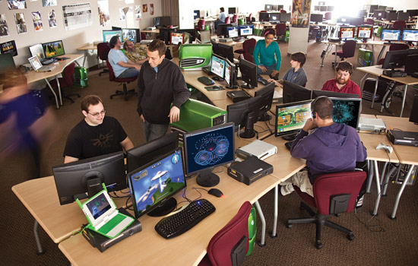
MAKING THINGS: mapped to teaching & learning
Nearly all of my courses are project based, and involve ‘making a thing’
The _grade_ is never about the thing made, but about the process followed while doing so
This is a really important distinction because I think what we are ultimately trying to instill is the skill and experience of how to reliably make a thing that we don’t already know how to make, a process that is preparation for the unknown

Slide 5
Program Mission
The mission of the undergraduate Game Design and Development program is to prepare students for careers within the entertainment technology landscape as well as other related areas, while still pursuing a broad-based university education. The program stresses its technical roots in the Computing and Information Sciences disciplines while engaging in the breadth of development processes through experiences in game design, design process, as well as the asset creation and production pipeline.
The program focuses on interactive systems development, but meets the industry need for developers who are involved in the totality of the design process. The program is intended specifically for students who aspire to hold careers within the professional games industry or a related field such as simulation, instruction or visualization, and focuses on preparing graduates who understand the technical roots of their medium, the possibilities that creative application of software development affords, and the way in which the digital media industry operates. In addition, the program provides graduates with a core computing education that will prepare them both for graduate study in a number of computing fields and for employment in more general computing professions.

Slide 6
PROGRAM GOALS
We expect that graduates of the Bachelor of Science in Game Design and Development program, three to five years after the date of graduation, will:
A) combine concepts in essential knowledge domains such as programming, mathematics, physics, and game design towards the realization of game design and development applications or related media-centric works.
B) work productively as game application developers, game designers, simulation and visualization application developers, and/or process tool developers within the games industry or a related media-centric discipline.
C) effectively communicate within the profession as well as recognize and interpret technical, social, cultural, ethical, and global indicators within the field.
D) work effectively in multidisciplinary concept design and/or software development teams.

Slide 7
STUDENT LEARNING OUTCOMES
apply knowledge of programming, math, physics, and game design to the field of game design and development (embodies Institute Program Outcomes 1 and 4 as well as contributes to Program Goals A and B).
identify, analyze, and resolve game design problems using industry-established game design and gameplay concepts (embodies Institute Program Outcomes 1 and 3 as well as contributes to Program Goals A, C, and D).
integrate game design and technology concepts in the practice of game creation (embodies Institute Outcomes 1, 4, and 5 as well as contributes to Program Goals A, B, and D).
identify and solve production pipeline issues related to the game design and development process (embodies Institute Program Outcome 1 as well as contributes to Program Goals B and D).

Slide 8
apply current technology in a media-centric context (embodies Institute Program Outcomes 1 and 5 as well as contributes to Program Goals B and D).
identify, critique, and apply knowledge of media theory, mediated communication, and aesthetics towards the construction of media-centric applications (embodies Institute Program Outcomes 1, 2, and 3 as well as contributes to Program Goals C and D).
identify critical legal and ethical challenges in the design and production of games (embodies Institute Program Outcome 3 and contributes to Program Goal C).
effectively communicate technical and design concepts through writing, speech, and formal presentation (embodies Institute Program Outcome 1 as well as contributes to Program Goals C and D).
effectively participate and contribute to multidisciplinary design and development teams (embodies Institute Program Outcomes 2 and 5 as well as contributes to Program Goal D).

Slide 9
TEACHING GAME PRODUCTION: COURSE LEARNING OUTCOMES
Course Learning Outcome | Assessment Method
7.1 Students will be able to identify and explain the attributes and components of the unique features and technologies in a given project. | Assessed through student writings and classroom discussion/participation in class and on-line.
7.3 Students will be able to create prototypes and/or fully functional projects based on the parameters and design documents created in class. | Assessed through final project completion and peer assessments.
7.4 Students will be able to evaluate and critique prototypes and provide constructive feedback to their peers. | Assessed through final project completion and peer assessments.
Notes:
Learning outcomes for the individual course (that are

Slide 10
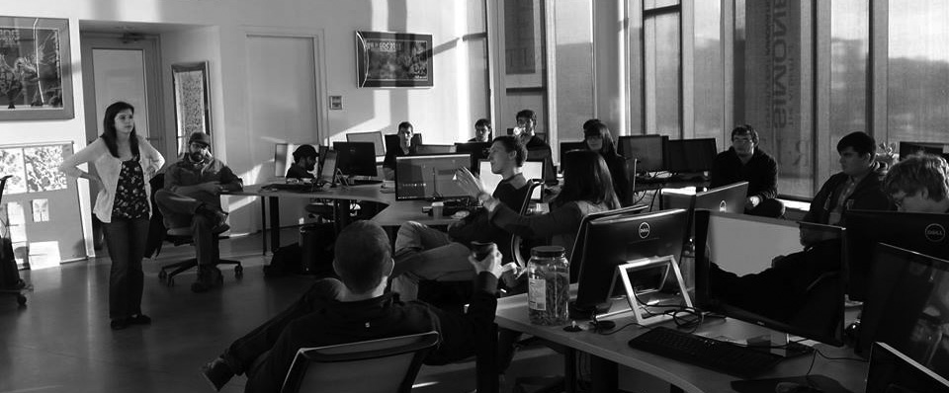
PRODUCTION COURSE: PROGRAM LEARNING OUTCOMES MAPPING
apply current technology in a media-centric context
effectively communicate technical and design concepts through writing, speech, and formal presentation
effectively participate and contribute to multidisciplinary design and development teams

Slide 11
PRODUCTION COURSE: DELIVERABLES
There will be daily check-ins by students with the PM.
There will be weekly update reports by every member of the class
There will be ‘milestone sprints’ as identified in the planning process (expect several of these throughout the semester, with associated due dates to be assigned during class based on the exact deliverables of the sprint)
There will be 4 major checkpoints (approximately weeks 3, 6, 9, and 12) – Exact dates will be given in class and will vary slightly based on schedules, production speed, and overall project cohesion
There will be weekly reviews of the master branch of development, for which all members of the class share responsibility.
There will be a final presentation of the game, along with associated documentation and process review, during finals week (week 16).
Notes:
This were the deliverables

Slide 12
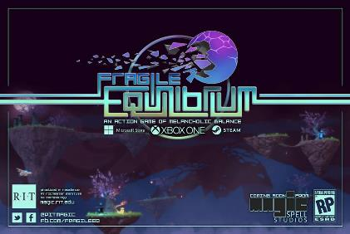
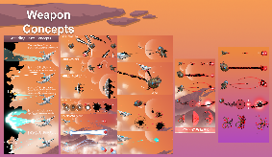
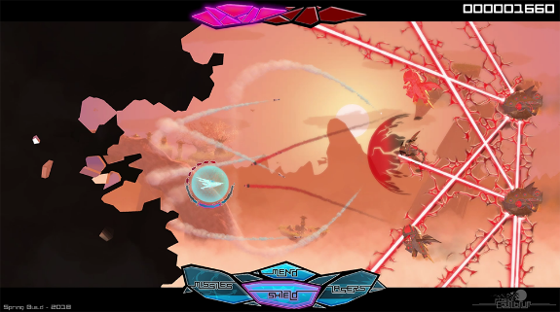
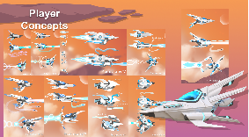
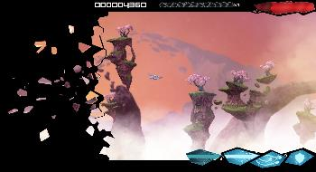
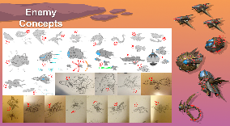
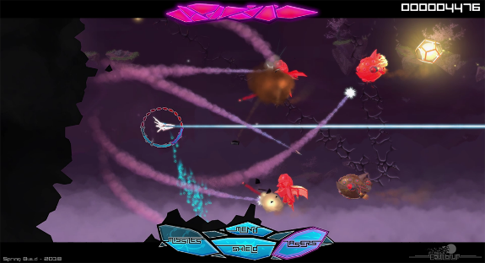
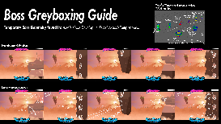
A FOCUS ON PROCESS, NOT ON OUTPUT

Slide 13
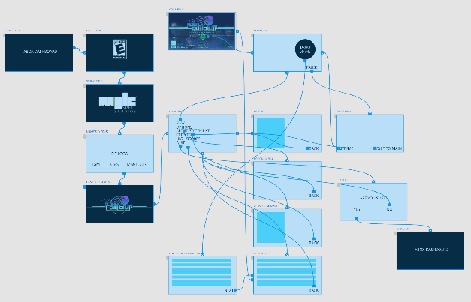
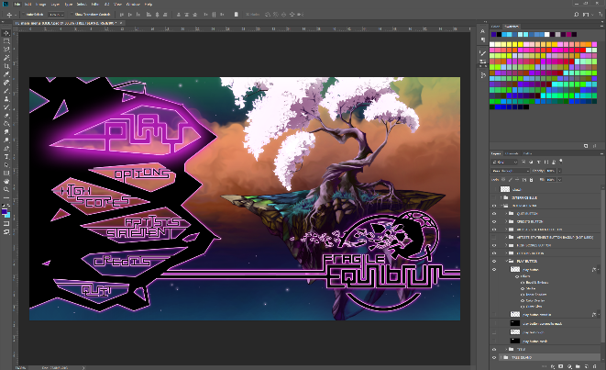
REVIEW OF DESIGNS NOT JUST IMPLEMENTATIONS

Slide 14
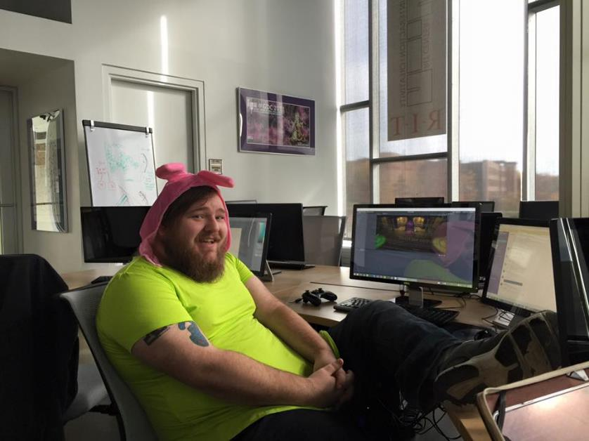
GRADING PERCENTAGES AND WEIGHTS
Nearly all of the grade will rest on the final deliverable (70%) – but with grades & discussions all along the way. This means that every discussion, opportunity, and review along the way is a chance to either continue great work and/or improve. It places the responsibility and opportunity in the hands of the students so engaged.
Peer assessment (15%) We used instruments that asked students to evaluate each other in context-aware professionalized roles relative to the structure of the course at several points during the semester, not just the end, and not just a simple scale
Documentation (15%) This was both design docs, technical documentation, presentations and materials during the process, etc. The tech makes this easier to capture.
Notes:
Breakdown of how a grade would be formulated for EVERYTHING WE DID – that meant every checkpoint and submission used these criteria, not just the end.

Slide 15
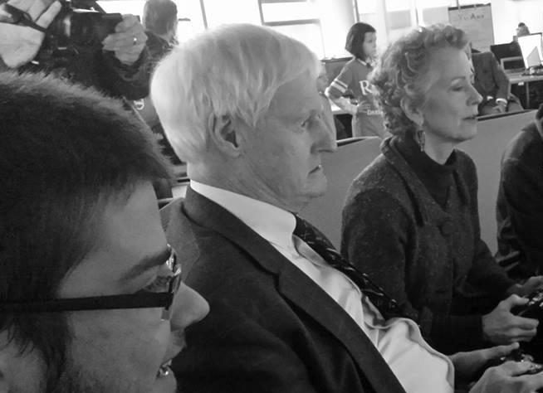
SEVERAL OPPORTUNITIES FOR FEEDBACK & REFLECTION (and pre-grade GRADES)
Critique is about the WORK and not the PERSON – day 1 (and everyday) lesson
Variety of sources, including INDUSTRY VISITORS, SCHOOL AGED CHILDREN, STUDENT IN OTHER MAJORS, and FACULTY, STAFF, and ADMINISTRATION
8 year-olds, dude
Internal and external
points of feedback

Slide 16
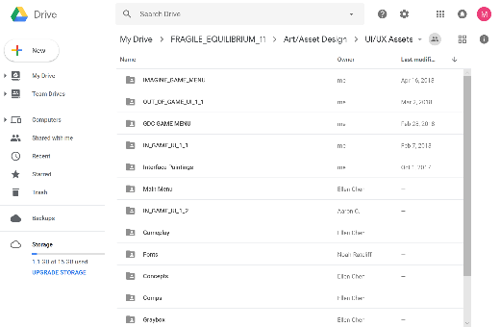
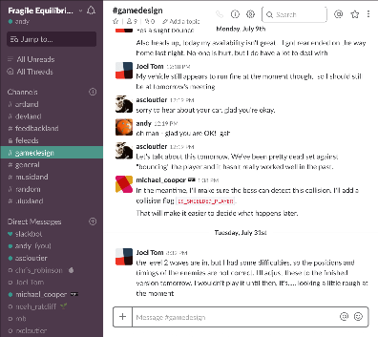
COMMUNICATIONS INFRASTRUCTURE
Notes:
This is how we measured some of communication, contribution, etc. Both quant (i.e. using systems to look) and qual (i.e. reading and analyzing whats there, and active participation in these same channels and venues with the students)

Slide 17
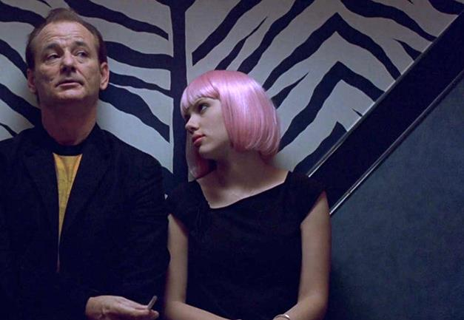
WHAT BIG PROBLEMS WERE WE TRYING TO SOLVE?
COMMUNICATION – Things get “Lost in Translation” between UI/UX, art, design, dev/engineering, QA…
FORMAL and INFORMAL LEARNING – Not just skills but skills applied to complex practice, situated learning in context. “learn by making things”
CULTURAL DEV & CAPABILITY – Where do games come from? What is a repeatable design process? How do studios work? Maturity & Palette?
ACADEMIC IMMERSION – creating a shared space between computing and the arts, between research and practice…
Notes:
Communication is the big one, not any individual tech skill which will fade away almost as immediately as it is necessary

Slide 18
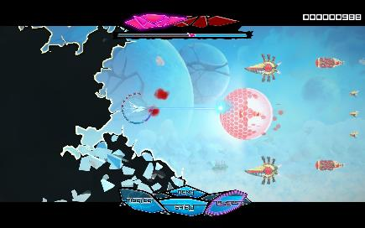
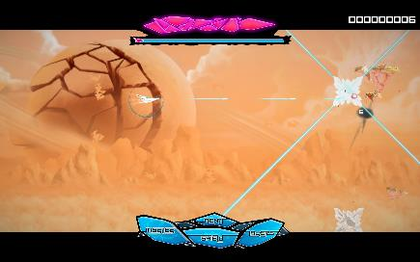
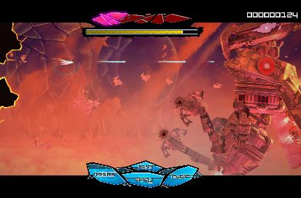
Notes:
So the game is out, the game is pretty and public and all fo those things – but the grade that students earned in that course was not because the final was pretty or because it got good reviews externally, but by adhering to a repeatable process, by engaging with each other, by demonstrating growth and ability relative to the course goals and outcomes

Slide 19
This means you can “fail” with a beautiful product, and “succeed” even if a product doesn’t GEL, BY DESIGN
Notes:
On the left is the game we wound up releasing. On the right is the first version – where students learned A LOT about game production, technology selection, integration, teamwork, and more, but the game itself just didn’t come together. Sometimes the learning isn’t in the final product, but in the act of making.

Slide 20
WE DID POST-MORTEMS FOR EVERY PROJECT, FOR EVERY PRODUCTION COURSE
Notes:
We’d usually hold a post-mortem after every production course, which was ostensibly about what we learned with the project, but a lot of the Q&A from faculty also focused on course delivery, retention of expert knowledge, and more.

Slide 21
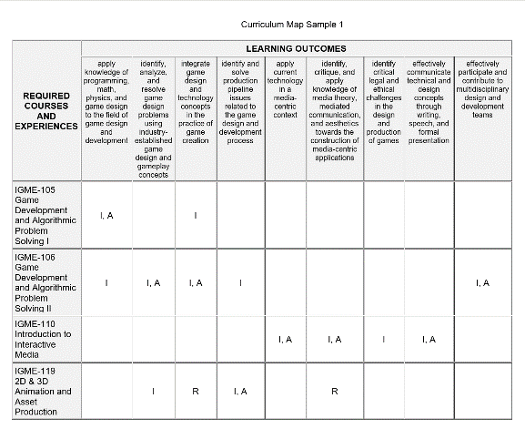
ALL OF WHICH CAME BACK TO PROGRAM ASSESSMENT & REVISION
Notes:
This is where grades individual courses would get analyzed to see if there were sustained bottlenecks we needed to revise, and if students were performing adequately in key courses that mapped directly to university learning outcomes (a function of middle-states accreditation and certification of degrees)

Slide 22
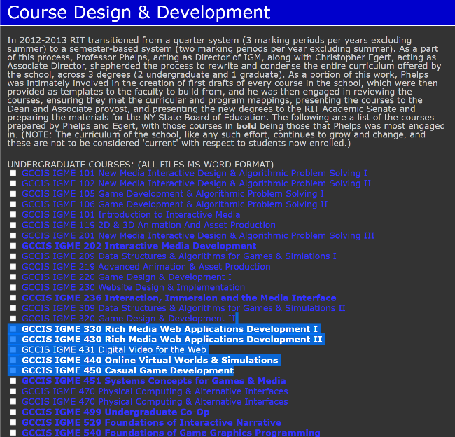
ALL OF THIS, FOR EVERY COURSE & DEGREE IS ONLINE FOR YOU IF YOU WANT IT

Slide 23
ANDYWORLD.IO | PROFESSORANDREWPHELPS.NET | @RITIGM1 |ANDYMPHELPS@GMAIL.COM
Thanks & Questions

